Slide 1
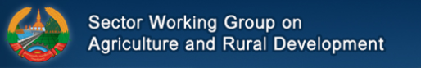
SWG-ARD Meeting
27th September 2017
Secretariat’s Presentation
----------
Mr. Savanh Hanephom
Deputy Director General
Department of Planning and Finance (DoPF)
Ministry of Agriculture and Forestry

Slide 2
Terms of Reference
SWG-ARD
  Updated to reflect recent structural and situational developments
  Retains the original objectives updated to include the SDGs
  Reflects the revised structure
  Recognizes the current Chair and Co-chairs
  Available in hard-copy or soft-copy for review
  Written comments welcome via e-mail to the secretariat within one week (by 4th October) at which time the draft will be considered accepted and submitted along with the annual report to MPI.
SSWGs: each of the four SSWGs now has an approved TOR.

Slide 3
SWG-ARD Structure
SWG-ARD
Core Working Group
SSWG-
FAB
SSWG-FORESTRY
SSWG-
ABD
SSWG-
RD
Policy Think Tank
Ad-hoc Working Groups
Notes:
Available as a hand-out is a more detailed structure along with a brief purpose statement for each of the SSWGs.

Slide 4
Impact from Typhoon SONCA’s
From the End of July and the 1st Week of August Typhoon SONCA swept through the country effecting agriculture and forestry:
Crops are worst affected by the floods, mainly lowland and upland rice affected 42,773 ha,
damaged only 21,788 ha in 11 provinces:
  Northern provinces: 445 ha (Oudomxay, Luangprabang, Xayabury and Huaphanh)
  Central provinces: 11,787 ha (Borkhamxay, Khamuane and Savannakhet)
  Southern provinces 9,556 ha (Champasack, Saravane, Sekong and Attapeu).
Irrigation channels have been damaged with many of the schemes in need of reconstruction
  Northern provinces: part of Lao PDR 37 schemes
  Central 14 schemes
  Southern 32 schemes
  Total = 83 schemes
Some large animals, such as cattle, buffaloes, pigs and many chickens and ducks were lost
Some damages were reported in fish ponds, and fish and fingerlings were lost in three Southern provinces (Champasack, Saravane and Attapeu).
Note: Preliminary Report of the Provinces; available figures are included.

Slide 5
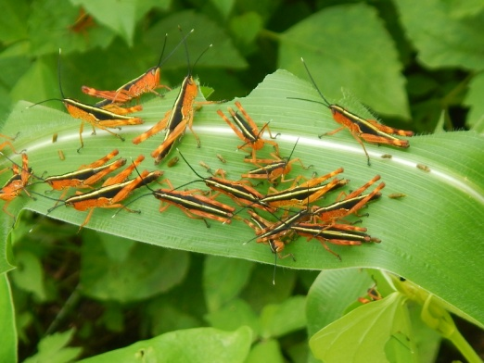
Creation of Regional Network on Management of Yellow-spined Bamboo Locust
Inception Workshop of FAO Regional TCP Project, 18th September, Luang Prabang
Regional information network comprising Lao PDR and Vietnam, with support from China and Thailand
2017: Development of surveillance network in affected districts (23 in Lao PDR and 25 in Vietnam) to monitor egg-laying
2018: Training on use of biological pesticides – biocontrol agents
2018: Deployment of biological pesticides in demonstration trials and medium-scale interventions

Slide 6
Danger Posed by Locusts
Extent of infestation:
By end of 2016, locusts affected 5 provinces (23 districts and 223 villages): total of 4,128 hectares of farm land
Impact on Crop production and Income
By Mid of 2017, locusts affected 5 provinces (24 districts and 399 villages): total of 6,205 hectares of farm land
Map Data:
2016

Slide 7
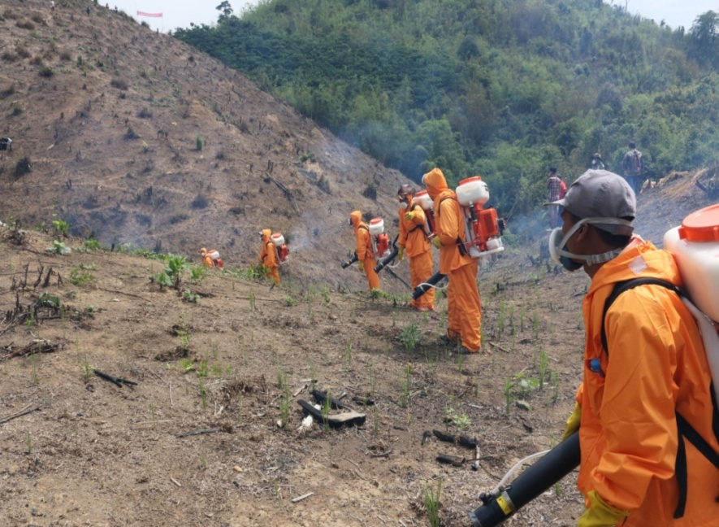
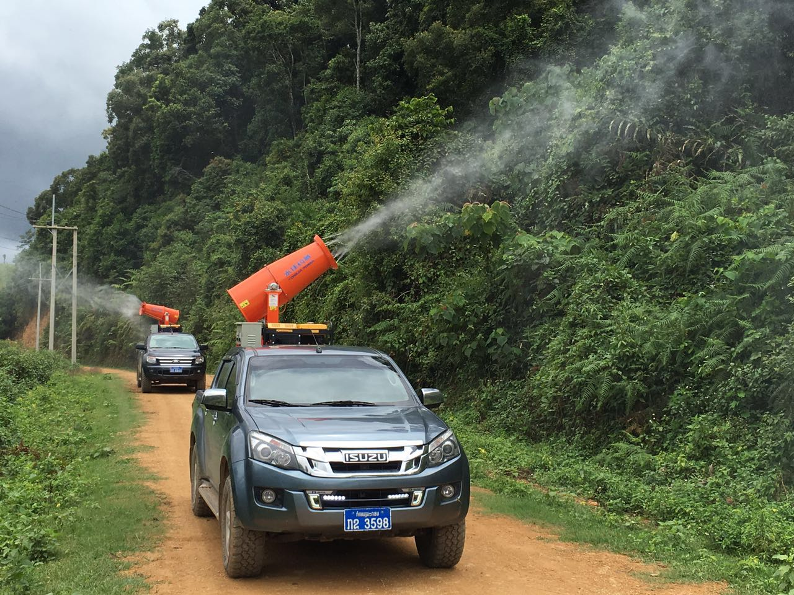
Actions taken
Information dissemination
Technical training with FAO support
Secured equipment and supplies from China and FAO
Spraying of affected areas

Slide 8
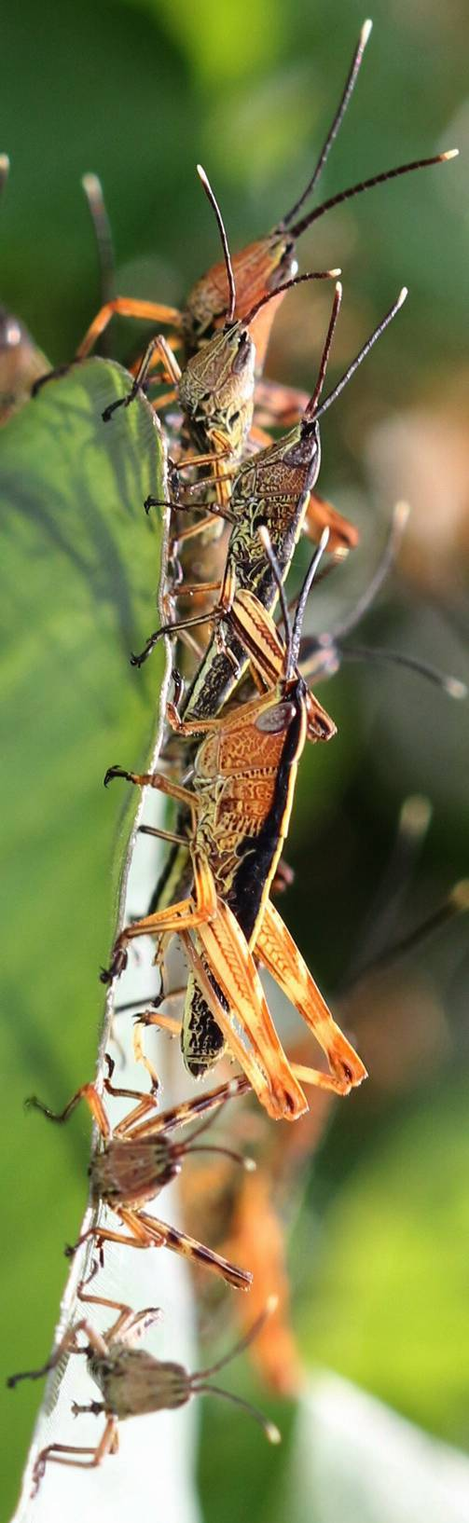
Plans for 2017
N | Activity | Implementation period 2017 (month)
 |  | 1 | 2 | 3 | 4 | 5 | 6 | 7 | 8 | 9 | 10 | 11 | 12
1. | Planning
2. | Training, equipment distribution, and staff assignment
3. | Field implementation (local knowledge, chemical use, destruction of eggs)
4. | Field follow up on the movement of locusts and surveying where they lay their eggs
5. | Summary and reporting and planning for 2018

Slide 9
First National Nutrition Technical Symposium:
Achieving SDG 2 through evidence-based programming in nutrition
31 Sept. – 01 Nov. 2017; ICTC (KM 5)
Organized by the National Nutrition Committee / Secretariat
Over 35 presentations from practitioners, researchers, and academics working throughout Laos
Range of topics: nutrition-sensitive agriculture, nutrition-sensitive education, nutrition-specific/sensitive health interventions, clinical nutrition, and multi-sectoral coordination/convergence
Including: good practice studies, issue studies, and international/comparative studies
Supported by a range of partners: EU, FAO, UNICEF, WFP

Slide 10
World Food Day and International Day for Eradication of Poverty 2017
“Change the future of migration. Invest in food security and rural development.”
Concept for the Day
The world is on the move, with an estimated 1 billion migrants today- majority moving within their own countries
Need to understand the nature and scale of these movements
Reasons for migration in Lao PDR: rural poverty; lack of employment; food insecurity; natural disasters; rural and urban inequality; lack of access to land; and depletion/degradation of natural resources
Government of Lao PDR and development partners realize the need to harness the potential of migration to support development and build the resilience of communities
Key messages for addressing migration
Address forced displacement due to natural disasters and root causes of movement
Invest in rural development through innovative policies that create business opportunities and jobs for young people that are not only agriculture-based
Reach the SDGs with the inclusion of all people
Protect and promote the rights of migrants, making migration safe, orderly and regular
Sponsored by the United Nations

Slide 11
World Food Day and International Day for Eradication of Poverty 2017
“Change the future of migration. Invest in food security and rural development.”
Saturday 14th October 06:00 at Patuxay Monument
  Minimarathon
Monday 16th October 13:30 at NAFRI Meeting Hall
  Seminar on “Change the Future of Migration”; Chaired by MAF and and Co-Chaired by UNDP; Panel members MAF, MLSW, MARD-Vietnam, IOM, UNFPA
  Exhibition – National Authorities and Development Partners
Tuesday 17th October 08:30 at NAFRI Meeting Hall
  Main World Food Day Celebration: Deputy Prime Minister, Minister of Agriculture and Forestry, UN Resident Coordinator, and FAO Representative
  Exhibition – National Authorities and Development Partners

Slide 12
Communication of SWG-ARD business
For communication of SWG issues and dissemination of materials, a google-drive folder has been established:
https://drive.google.com/drive/folders/0BzTaYIoitEIHdWtBdzg1UFhtZ2c
Agendas, presentations, minutes, TOR and structure, and other materials will be shared as available
The web site for the SWG will be improved, updated, and reactivated and will serve as the long-term home for official documents.

