Slide 1

Strengthening Multi-sectoral Collaboration using One Health approach
Presented By:
Dr. Somphanh CHANPHENGXAY
Director General
Department of Livestock and Fisheries

Slide 2
Outline
Theme and Scope of One Health and Partners
Legal Framework to support One Heath
Main Activity Areas
Key Challenge and Proposed plans

Slide 3


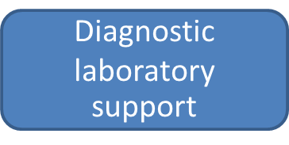
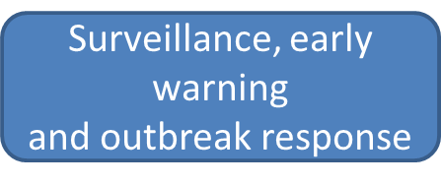
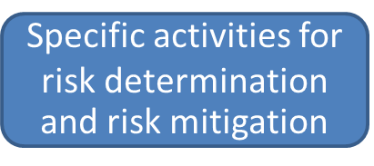
Theme of One Health

Slide 4

Scope of One Health
Zoonosis (disease transmitted from animal to human)
Emerging Infectious Diseases (EIDs) and re-Emerging Infectious Diseases (re-EIDs)
Transboundary Animal Disease
Food safety and food security
Anti-Microbial Resistance (AMR)

Slide 5
Priorities and Partnerships
DLF Capacity Assessments and Road Map development
  Joint Evaluation Exercise (JEE) – supported by WHO, FAO, USAID
  Global Health Security Agenda (GHSA) – supported by USAID
DLF capacity development with support from ADB, FAO, Government of Hungary, IAEA, OIE, Oxford University, WHO, USAID, US-DTRA on:
- Human resources
- Laboratory capacity
- Field Epidemiology
DLF outbreak response in collaboration with MOH with support from FAO, WHO, US-CDC, USAID on:
  Avian Infleunza (AI)
  Anthrax
  Rabies
  LPB,XYB,VTE,CPS,SRV
DLF knowledge sharing in collaboration with MOH supported by FAO and WHO, for example:
  One Health Conference, Lao PDR, November 2016

Slide 6
Legal framework to support One Health
MOU between MAF and MOH signed 2008
National Avian Influenza committee
Mechanism coordination between two sectors
Join National EIDs 5 year workplan (2016-2020)
Join National Anthrax control

Slide 7
Legal framework to support One Health
Identify 5 priority zoonosis diseases
Join National Preparedness and Contingency Plan for Avian influenza H5N1,H7N9 signed 2016
Join National Rabies control plan under the process for approval
Join Draft National Action Plan on Anti-Microbial Resistance Drafted 2016

Slide 8


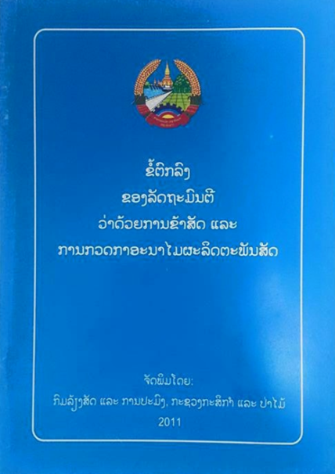
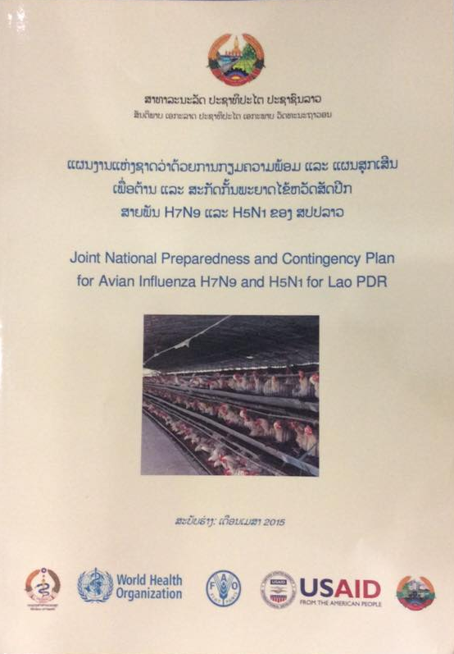
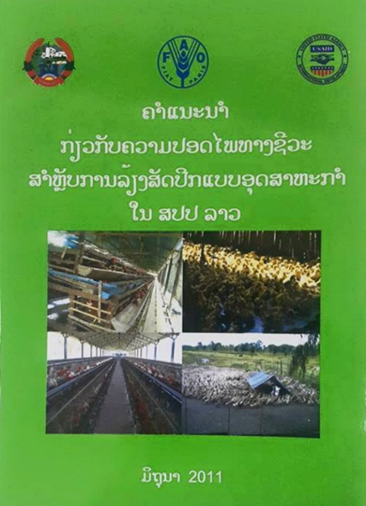
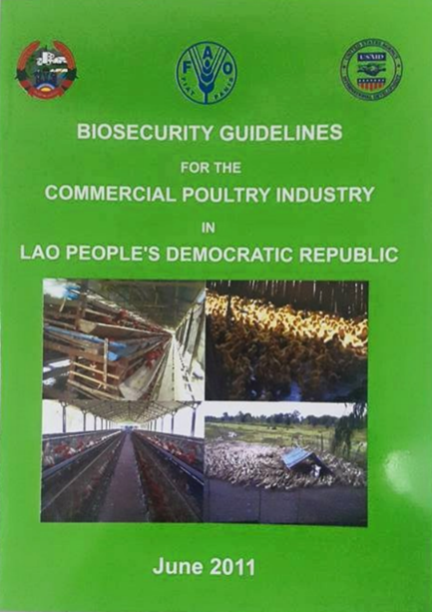
National control and prevention measures for poultry diseases
Emergency Preparedness
Joint Meetings on Surveillance, Control and Prevention of Avian Influenza between Lao PDR and Thailand, 27-29 July 2015

Slide 9
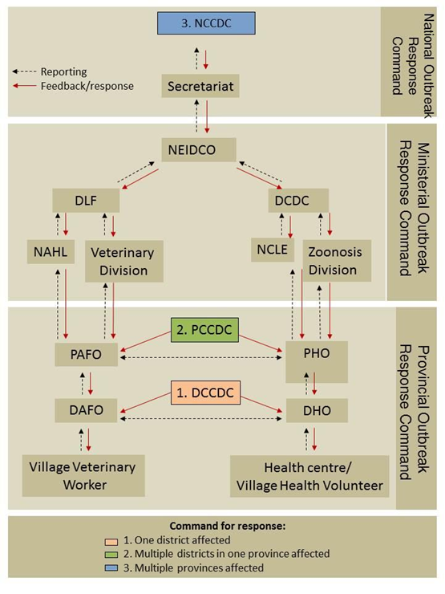
Cross-sectoral Coordination Mechanism

Slide 10
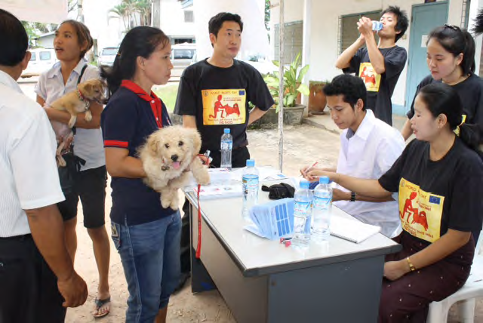
Improved understanding of Public Health threats
World Rabies Day
Annual event- MOH and MAF take turns hosting
Expanded to 7 priority provinces with highest incidence
Increase public awareness of rabies
Pet Vaccinations and IEC materials
supported by OIE
Promote pet vaccination in
communities

Slide 11
National Animal Health Laboratory

Slide 12
NAHL - Assessment of Laboratory Capacity with support of FAO
Identify gaps
Capacity Building Program
Assessment
(2012 / 2014)
Technical inputs
LMT-Indicators
Geographic location
Laboratory Budget
Basic supply
Organization
Linkage with satellite labs
Communication means
Infrastructure
Equipment
Reagent supply
Staff skills and availability
Sample accession
Available technology
Training
Quality Assurance
Biosafety/Biosecurity
Staff Security/Health
Laboratory collaboration
Use of databases/platforms
FAO-Laboratory Mapping Tools (LMT)
EMBL 5th Ed.
Expert’s
recommendation
Notes:
The first assessment of lab capacity was carried at the old premise using “Lab Mapping Tool” with various indicators.

Slide 13
2012 NAHL Laboratory assessment result
Indicator category | %
Available technology | 29.6
Basic supply | 33.3
Biosafety/Biosecurity | 22.2
Communication means | 16.7
Equipment | 33.3
Geographic location | 33.3
Infrastructure | 33.3
Laboratory Budget | 0.0
Laboratory collaboration | 46.7
Linkage with satellite labs | 0.0
Organization | 33.3
Quality Assurance | 16.7
Reagent supply | 25.0
Sample accession | 16.7
Staff Security/Health | 0.0
Staff skills + availability | 20.8
Training | 28.6
Use of databases/platforms | 25.0
Total | 24.2%
Need for improvements in
laboratory management system,
biosafety management, and
laboratory quality assurance
Note: results taken from the old laboratory facility
Notes:
The obtained results indicate that major gaps and needs for improvement NAHL diagnostic services in several aspects, in particular, the need for improvement of laboratory management system, biosafety management, and laboratory quality assurance.

Slide 14
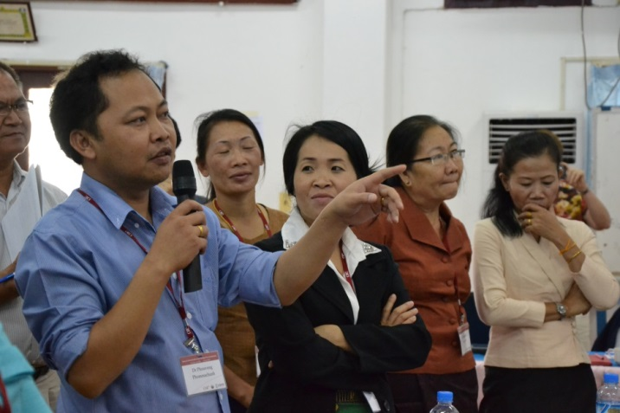
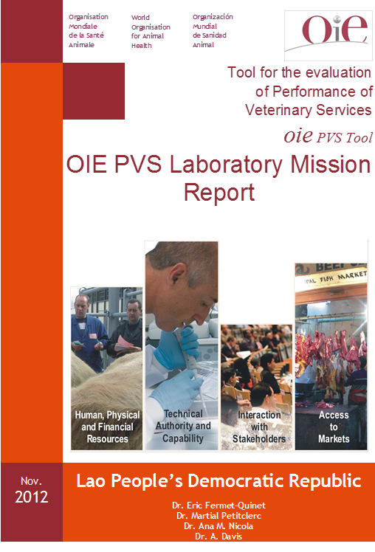

NAHL
Capacity Assessment- April 2013
with support of OIE
Database and Information system
Quality Assurance International standards, Networking and Collaboration / Coordination
Human Resource Capacity and Specialization
Governance and Management
Research and development
Notes:
Draft strategic plans developed and action plans drafted by each of National Animal Health Laboratories during the National Animal Health Laboratory Strategic Planning Workshops (cross-referenced with Objective 3). Participants included the laboratory director and staff of the national laboratory, the directors of regional/provincial laboratories, key players from various divisions such as the department of animal health and production, the Ministry of health and academia who work closely with the national animal health laboratory. During the workshop process, invited experts, OIE and EPT partners are also invited to provide comments and recommendations on the strategies and action plans developed by the participants.
Lab’s visions, mission, goals, strategies and action plans for 5 years are implemented by the national animal health lab staffs.
This activity reflect the elementary thoughts of individual laboratory based on SWOT and stakeholders analysis.

Slide 15

NAHL
Infrastructure
Background: LMT score
Budgets
Improper training allocation
Lab management and inventories
(Incl. database / sample flow/transport)
Biosafety and biosecurity
Incl. staff health and waste management
Quality of
diag. service
24.2%
GOAL: > 50%
Gaps and Needs
Manageable gaps
By external assistance
Lab management
Biosafety
Quality assurance
MORU-NAHL Technical assistance program
Since June 2013
Notes:
Based on the gaps identified from the baseline assessment, there are 3 areas that can be managed from external assistance including lab management, biosafety and lab quality assurance and management. FAO developed the collaboration with Mahidol-Oxford Research Unit (MORU) to provide technical assisatnce to NAHL in improving these 3 areas of gaps during 2013-2014.

Slide 16
NAHL
Infrastructure
Background: LMT score
Budgets
Improper training allocation
Lab management and inventories
(Incl. database / sample flow/transport)
Biosafety and biosecurity
Incl. staff health and waste management
Quality of
diag. service
2012
AIM
24.2%
GOAL: > 50%
Gaps and Needs
Manageable gaps
By external assistance
Lab management
Biosafety
Quality assurance
MORU-NAHL and Regional QA program
Monitoring and calibration of equipment (freezer, BSC, centrifuge, thermometer, pipette etc.)
For selected assays
  Develop SOPs, test cover sheet
  Assay controls
  Determine the effectiveness of internal quality control reagents and make recommendations
Support external quality assurance program
Quality management program + accompanied trainings
Sample storage and inventories, appropriately linked to LIMs
Documentation system
ISO 17025
(to be accredited within 3-5 yr)
Selected assays performed
at NAHL- Virology / Bacteriology /
Parasitology
Priority given to influenza
surveillance testing
Notes:
Under the quality assurance and management, it is linked with Regional QA and PT Program. NAHL, DLF has aimed to be accredited for ISO 17025 in 3-5 years. The following areas are focused to ensure that the laboratory diagnosis and services are in quality: Monitoring and calibration of equipment (freezer, BSC, centrifuge, thermometer, pipette etc.)
For selected assays
Develop SOPs, test cover sheet
Assay controls
Determine the effectiveness of internal quality control reagents and make recommendations
Support external quality assurance program
Quality management program + accompanied trainings
Sample storage and inventories, appropriately linked to LIMs
Documentation system

Slide 17
NAHL: LMT Assessment Result (2012 vs 2014)
% Total score 24.2% >> 43.9% >> 48.4%
Improvements were demonstrated in 15 of the 18 categories, with the greatest being in the area of basic supply and organisation followed by quality assurance.
Notes:
At this stage when we compare the LMT score with the one conducted in 2012, % Total score 24.2% >> 43.9% >> 48.4%
Improvements were demonstrated in 15 of the 18 categories, with the greatest being in the area of basic supply and organisation followed by quality assurance.

Slide 18
Regional Networking, Training, and Mentoring
2010-2014
Training & Mentoring
 | Diagnostics | Quality Assurance |  | Biosafety
 | No. People x Days in training | No. People x Days in training | No. FAO Experts x Days for mentoring at labs | No. People x Days in training | No. FAO Experts x Days for mentoring at labs
Cambodia | 110 | 22 | 13 | 16 | 7
Lao PDR | 122 | 17 | 119* | 26 | 23
Indonesia | 164 | 94 | 36 | 21 | 40
Malaysia | 134 | 79 | 13 | 35 | 7
Philippines | 112 | 44 | 10 | 16 | 8
Thailand | 224 | 74 | 14 | 67 | 13
Vietnam | 254 | 91 | 27 | 155 | 6
Bangladesh | 4 | 0 | 0 | 20 | 11
Nepal | 4 | 0 | 0 | 20 | 5
Bhutan | 0 | 0 | 0 | 10 | 6
TOTAL | 1,128 | 421 | 196 | 386 | 126
* With country-specific laboratory capacity building program in collaboration with MORU.
Notes:
This slide shows number of person-day that NAHL staff have received the trainings in each area, diagnostic, quality assurance and biosafety comparing to the region. Comparing to the size of the country, Laos has received sufficient training so far.

Slide 19
Laboratory strengthening
Conduct risk assessment for laboratory capacity
Improve laboratory management ( inventory, data recording..)
Improvement of biosafety and biosecurity
Participate in Quality Assurance and Quality control in alignment with ASEAN framework

Slide 20
Disease Surveillance

Slide 21
Surveillance activities on AI and other zoonosis
Provide equipment and field supplies in high risk areas to enhance surveillance activities on AI
Provide equipment for outbreak response in:
  Phongsali
  Luang Namtha
  Oudomxay
  Xyabouly
  Vientiane Province
  Vientiane Capital
  Luang Prabang

Slide 22
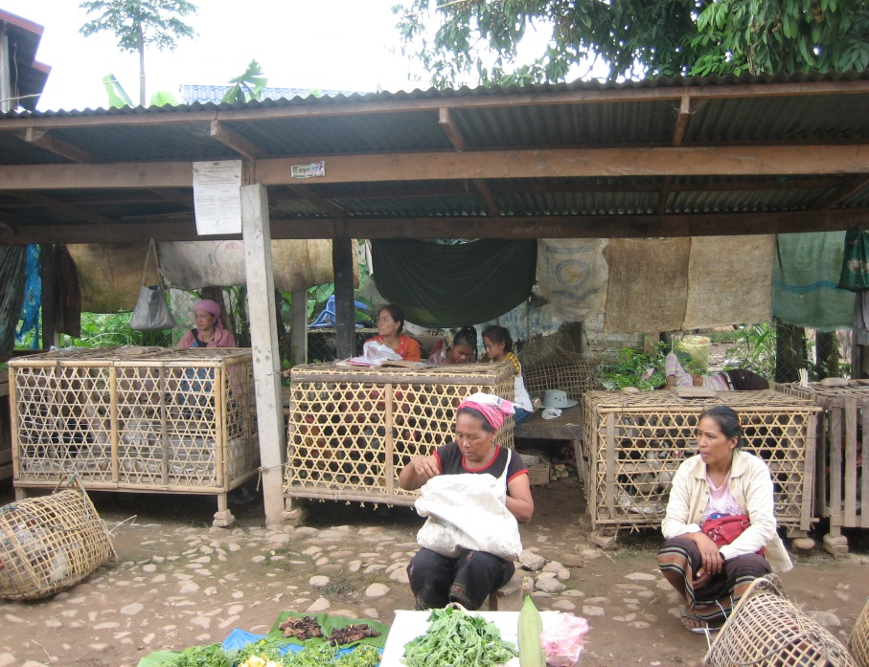
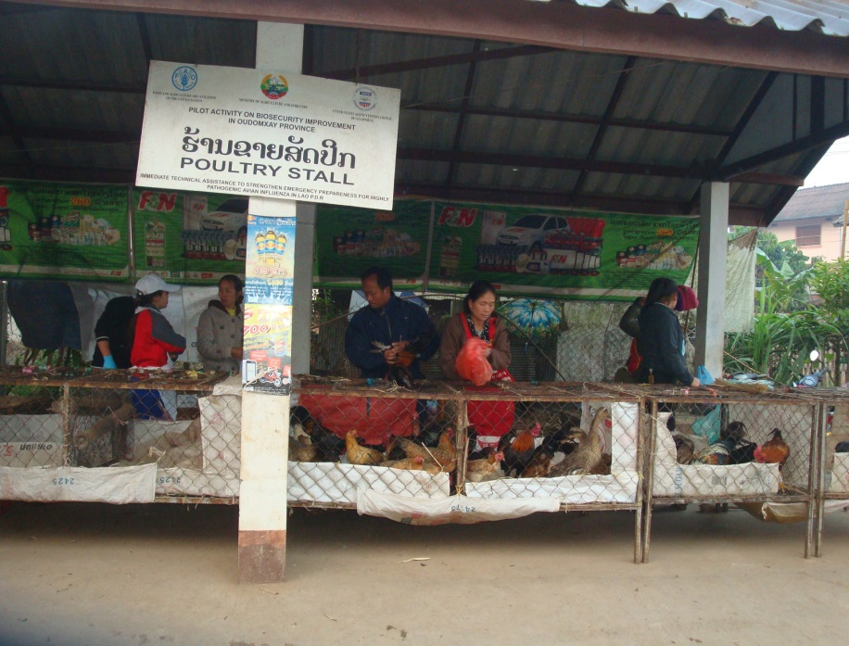
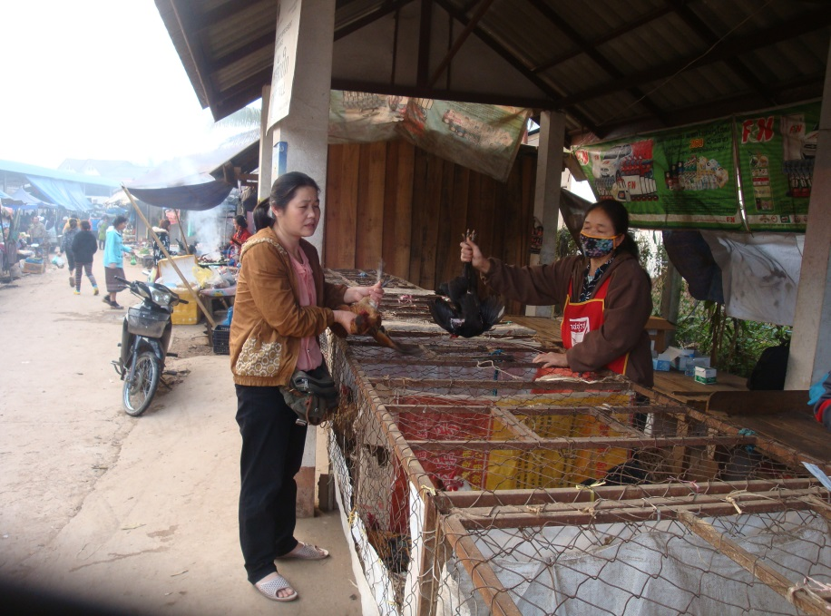
Biosecurity improvement in live bird market
in Oudomxay, Lao PDR
New live bird market
Old live bird market

Slide 23
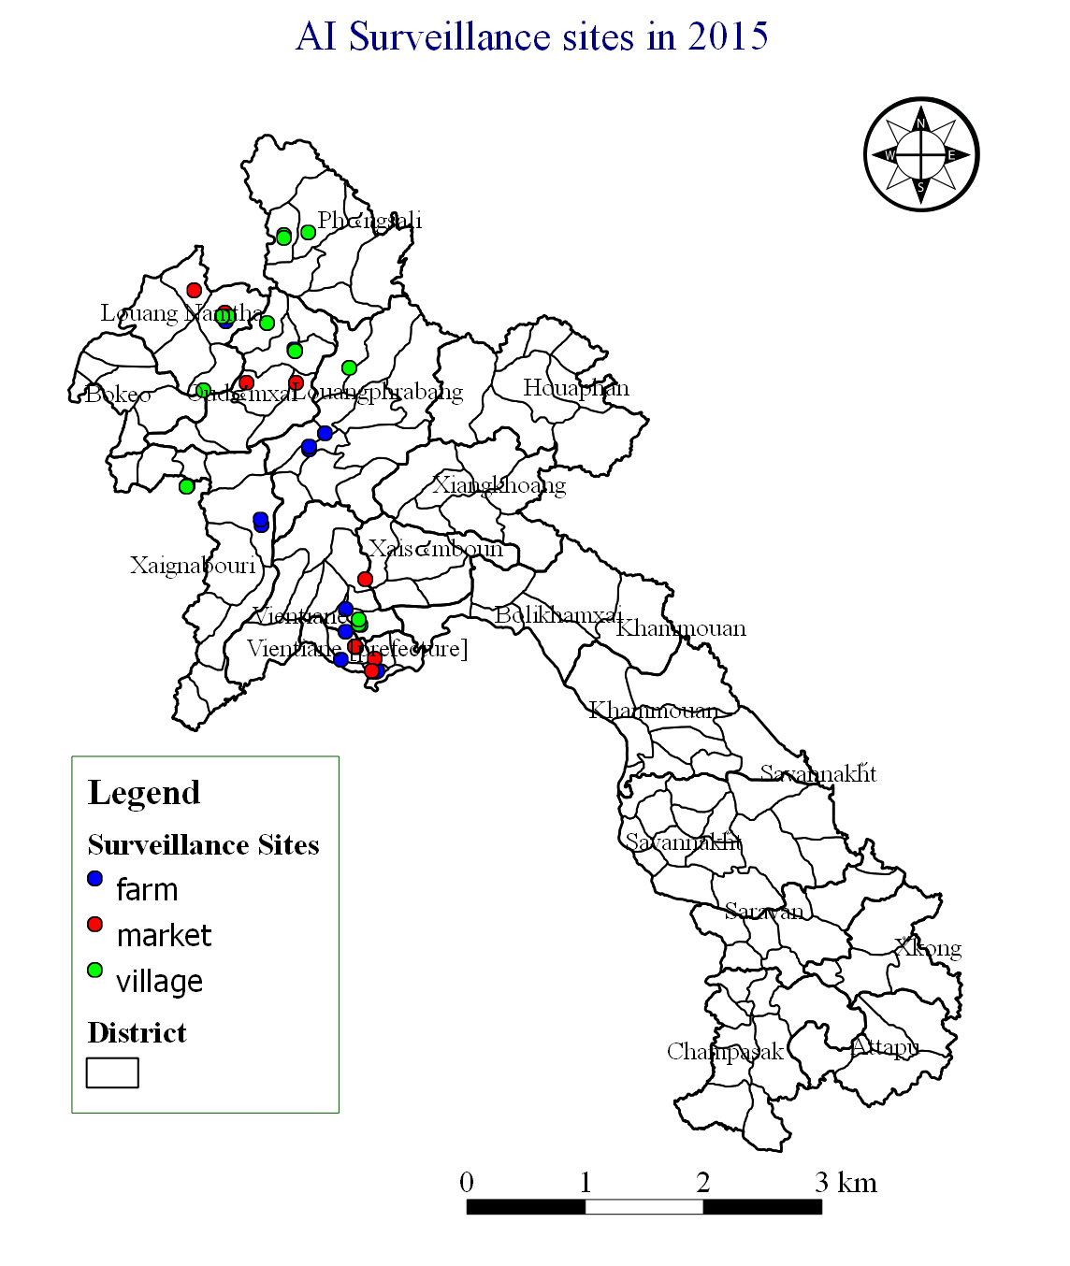
AI Surveillance in 2015
High risk provinces: 7
  PSL, LNT, ODX, LPB, XYL, Vte province, and Vte Capital
  9 target districts
Surveillance sites: 32
  9 LBMs
  8 village poultry, and
  15 poultry farms (Chicken & duck)
Number of samplings: 6
(1) 9Nov15; (2) 23Nov15;
(3) 7Dec15; (4) 21Dec15; (5) 4Jan16; and (6) 18Jan16
Sampling intervals: every 2 weeks

Slide 24
H7N9,H5N1 Active Surveillance Plan In 2015
Province | Swabs | Serum | Total
Phongsaly | 1740 | 375 | 2115
Luang Namtha | 1500 | 225 | 1725
Oudomxay | 1020 | 75 | 1095
Luang Prabang | 1260 | 0 | 1260
Xayabouly | 210 | 0 | 210
Total | 5730 | 675 | 6405
A total of 5,530 samples were received in 2015, and 85% of plan completed.

Slide 25
Number of swab samples positive with Flu-A by sample type
Sample type | Number of samples tested | No. of Flu A +ve | H5N6 +ve
Carcass | 4 | 4
Faecal | 423 | 25
Oropharyngeal | 4131 | 262 | 36
Serum | 672 | 0
Water | 300 | 22
Total | 5530 | 313
    For H7N9 virus: NOT DETECTED

Slide 26
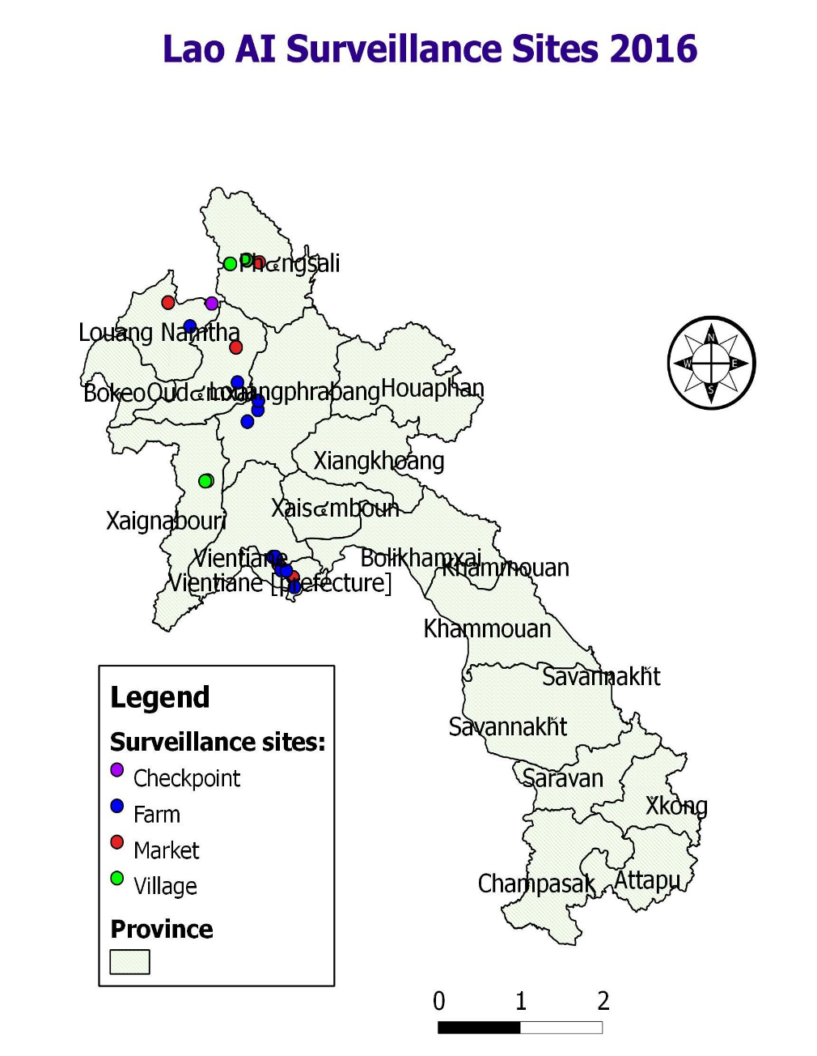
Active Surveillance 2016
Locations: 7 provinces (PSL, LNT, ODX, LPB, XAYA, VP & VC
Surveillance sites:
  LBM
  Farms (Chicken&Duck)
  Villages
  Checkpoint
Samples collected:
  Swabs (Ch&D): 4,437
  Serum (D): 2,215
Sampling period:
Jan-March 2016
Jul 2016 – Jan 2017
# of Sampling:
6 times ( 2 weeks interval)
6 times (1 month interval)

Slide 27
Samples collected by sample type in 2016
(from Jul 2016 – Jan 2017)
Province | Swabs | Sera | Total
Luangnamtha | 851 | 150 | 1001
Luangprabang | 358 | 124 | 482
Oudomxay | 516 | 156 | 672
Phongsaly | 842 | 290 | 1132
Vte Capital | 805 | 750 | 1555
Vte Province | 450 | 450 | 900
Xayabouly | 615 | 295 | 910
Total | 4437 | 2215 | 6652
Waiting the result

Slide 28
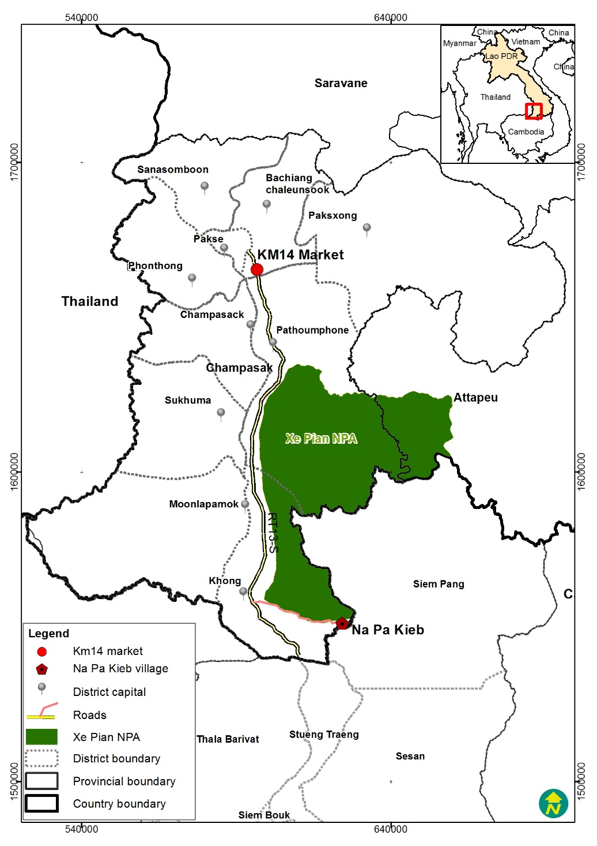
Synchronized Surveillance
March 2016 - January 2017
Location: Napakieb, Champasak
Surveillance sites: Village
Species: Buffalo/Cattle, pig and poultry (Ch&D)
Animal sampled: 471
Samples collected: 2825
  Swabs: 1,710
  BL& Serum : 1,115
Sampling times: 3
Mar2016, Jul2016 and Jan, April and July 2017
Waiting the result

Slide 29
Lao PDR - AI outbreaks in 2010 - 2015
Year | Provinces | Specie | Number of outbreaks and Samples positives | In country (NAHL) | Lab. Reference (Geelong) | Poultry Death& Culled
May, 2010 | Vientiane Capital (1F) | Chicken | 1 (2) | Flu A; H5N1 | H5N1 (2.3.4) | 1004 culled
2011 – 2013 NO OUTBREAKS
Mar, 2014 | Xayabouly (1V) | Chicken, duck | 1 (3) | Flu A; H5N1 (Xayabouly) | H5N6 (2.3.4) | Sus:5142birds (457death+ 543culled)
Jul, 2014 | Luang Prabang (1V) | Chicken, duck | 1 (36) | Flu A; H5N6 (LPB) | H5N6 (2.3.4) | Note: active surveillance programme
Sep, 2015 | Xayabouly (1V) | Chicken, duck | 1 (3) | Flu A, H5N1 | H5N6 (2.3.4) | Sus:1686 birds (314death +848culled)

Slide 30
Lao PDR: AI outbreaks in 2016 - 2017
Year | Provinces | Specie | Number of outbreaks and Samples positives | In country (NAHL) | Lab. Reference (Geelong) | Poultry Death& Culled
Sep, 2016 | Luang Prabang (1V) | Chicken, duck | 1 (3) | Flu A; |  | 577 dead &
 |  |  |  | H5N1 | N/A | 99 culled
Jan, 2017 | Vientiane Capital (1V) | Chicken, duck | 1 (3) | Flu A; |  | 1,000 culled
 |  |  |  | H5N1 | N/A
Feb, 2017 | Vientiane Capital (1V) | Chicken, duck, turkey | 1 (2) | Flu A; |  | 817 culled
 |  |  |  | H5N1 | N/A
Jul, 2017 | Xaysomboun (4 farms) | Duck, hens | 4 (3) | Flu A; | N/A | 8,750 dead &
 |  |  |  | H5N1 | N/A | 4,791 culled
Aug, 2017 | Champasak (1 farm) | Hens | 1 (6) | Flu A; |  | 8,750 deads &
 |  |  |  | H5N1 | N/A | 50 culled

Slide 31
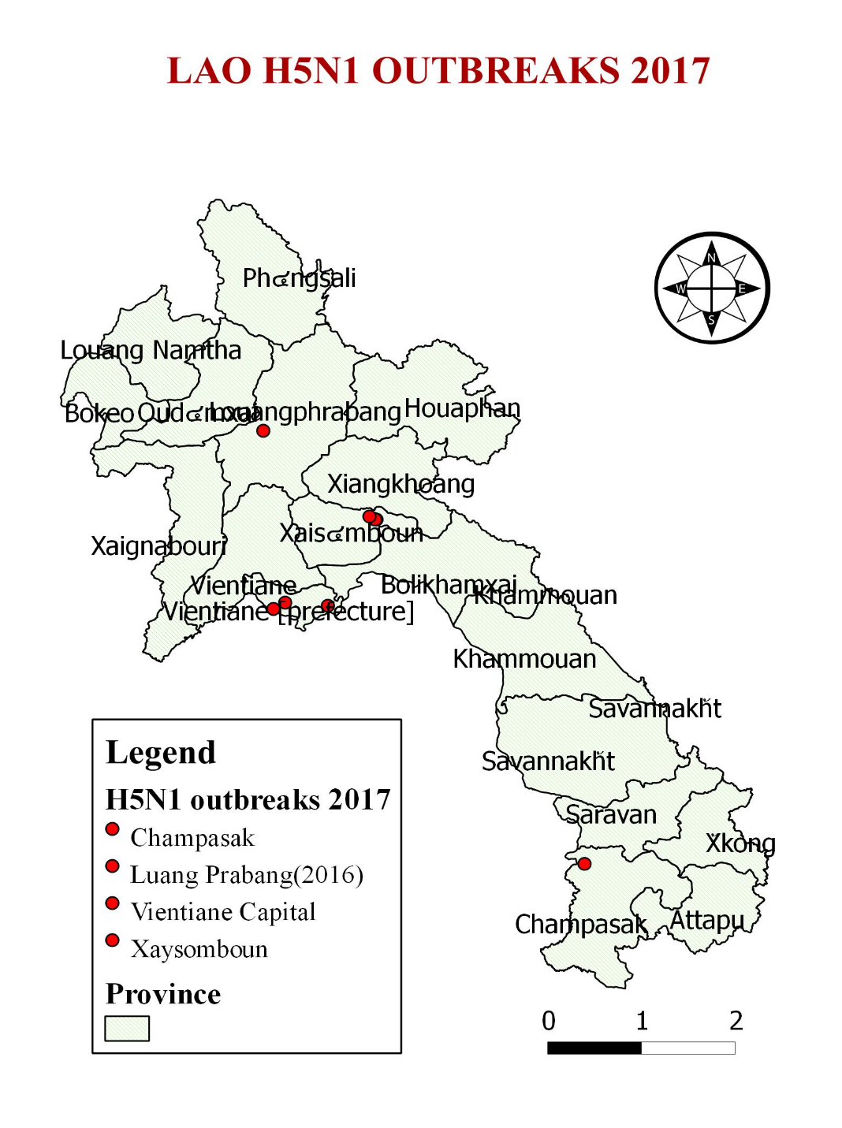
LAO H5N1 OUTBREAKS IN 2016 & 2017
1 Outbreak in LuangPrabang
Time: Sep 2016
District: Luang Prabang; Village: Viengsavan
Species: Chicken & Duck
Poultry dead & culled: 676
2 Outbreaks in Vte Capital
Time: Jan & Feb 2017
District: Naxaythong & Pak Ngum
Villages: Dongxiengdy, Nagnang & Done Hai
Species: Chicken, duck & turkey
Poultry culled: 1,817
4 Outbreaks in Xaysomboun
Time: Jul 2017
District: Thathom
Villages: Phiengta,Pou, Hadsamkhone & Nasong
Species: Duck and hens
Poultry dead & culled: 10,536
1 Outbreak in Champasak
Time: Aug 2017
District: Sanasomboun. Villages: Donglankham
Species: Hens
Poultry dead & culled: 8,800

Slide 32
Disease Response

Slide 33
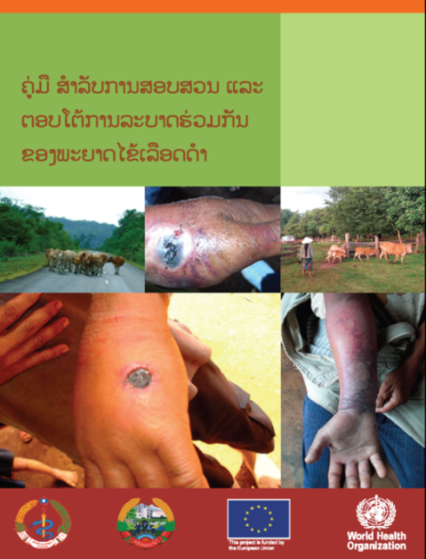
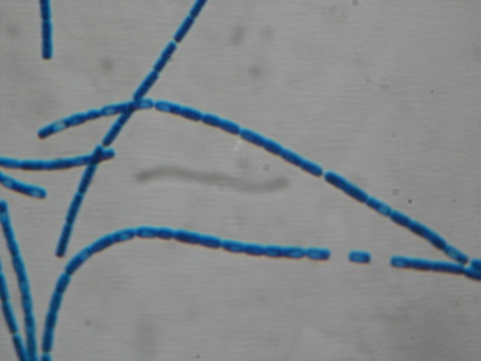
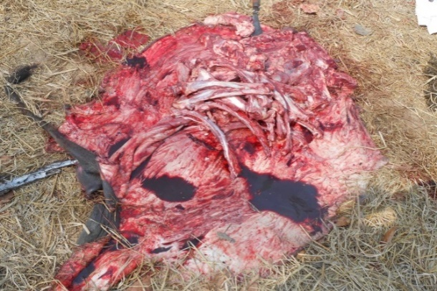
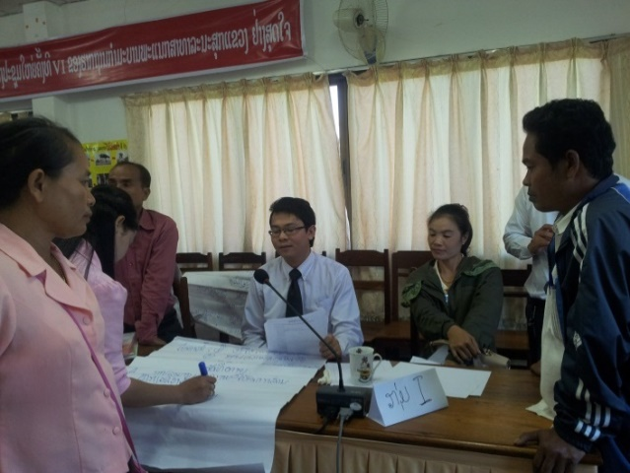
Coordinated response activities
Developed joint guideline for Anthrax outbreak
investigation and response + dissemination workshop
in two affected provinces
Collaboration on zoonotic disease outbreak response-
  Anthrax outbreak investigation in Saravanh province, Lao PDR
  Rabies outbreak response in Xayabouly province, Lao PDR with
  vaccine provided to more than 70 human patients with dog bites.
  Worked collaboratively with CARE (NGO)
Notes:
dissemination workshop conducted in two affected provinces is kind of capacity building

Slide 34
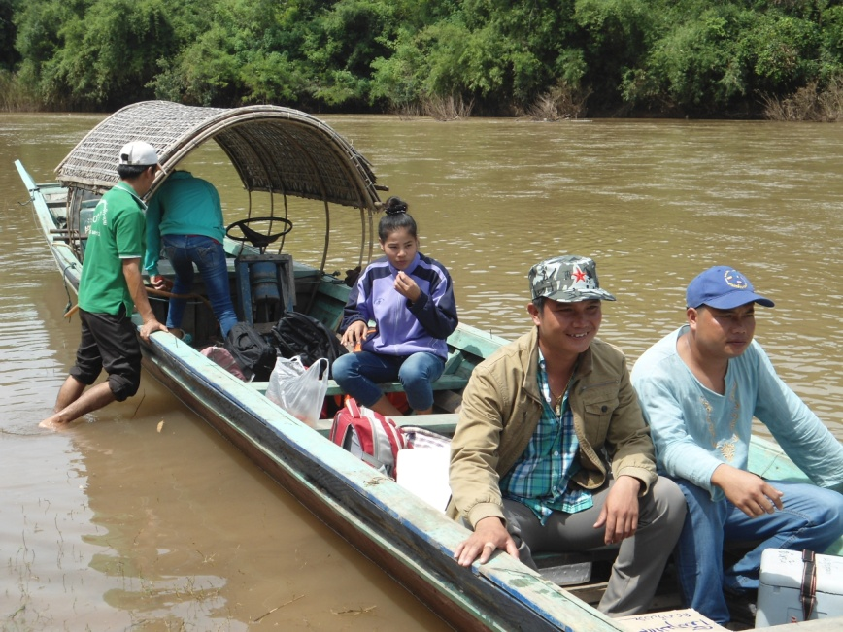
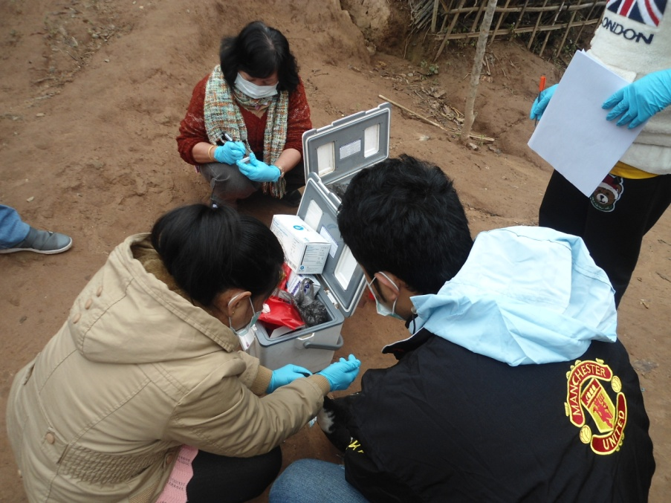
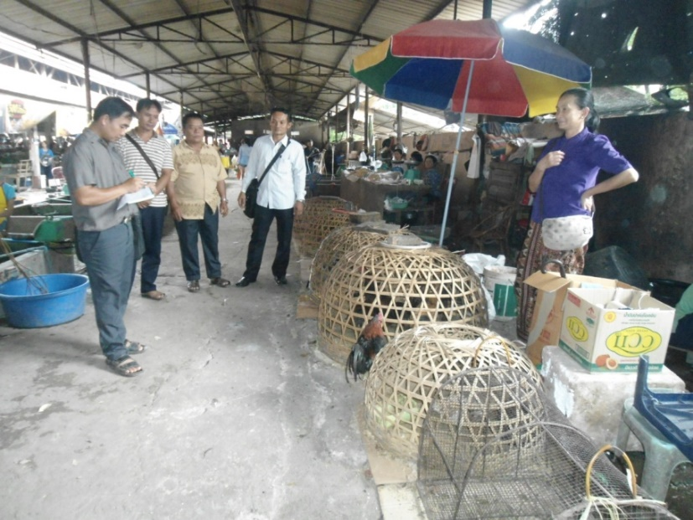
Joint outbreak investigation
in Nalae District, Luangnamtha in 2015

Slide 35
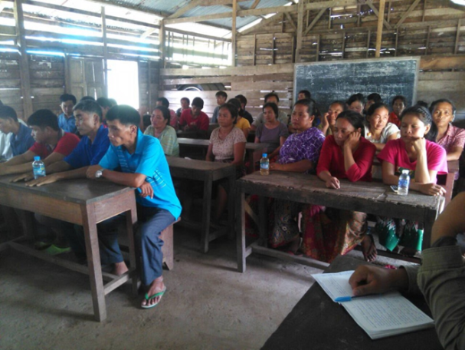
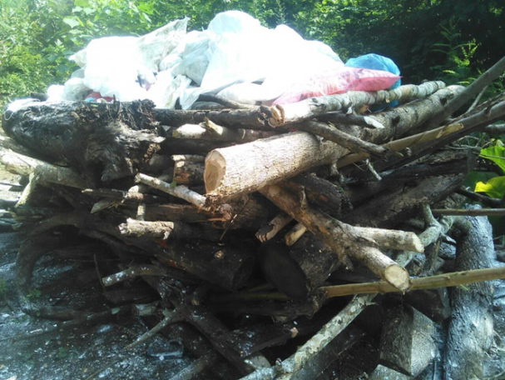
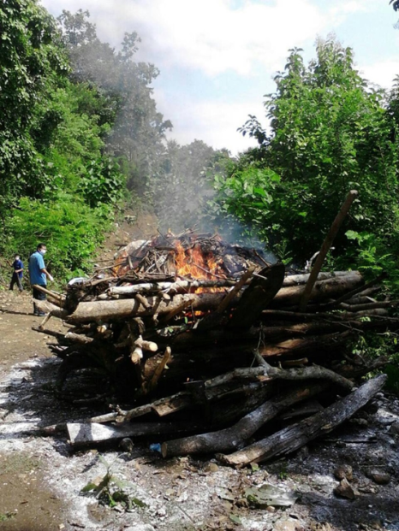
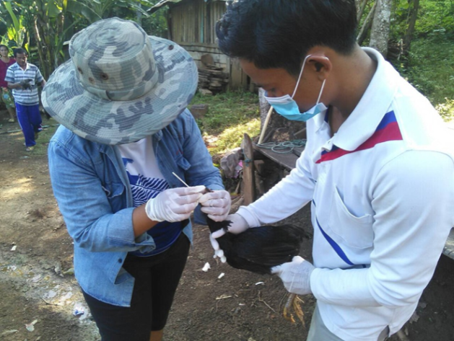
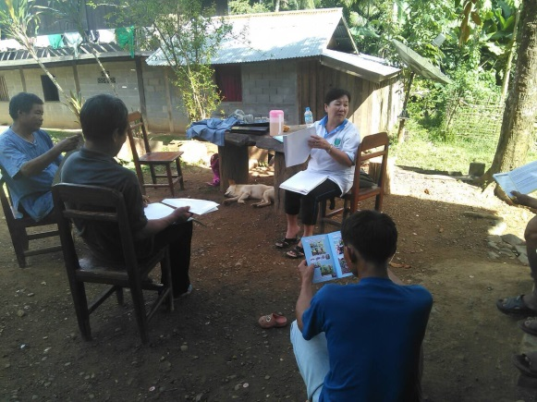


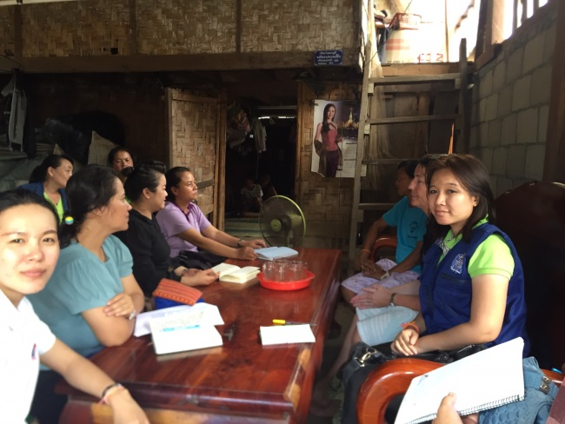
Joint outbreak response in Xayabouly – 2015 & 2016

Slide 36
Preparedness

Slide 37
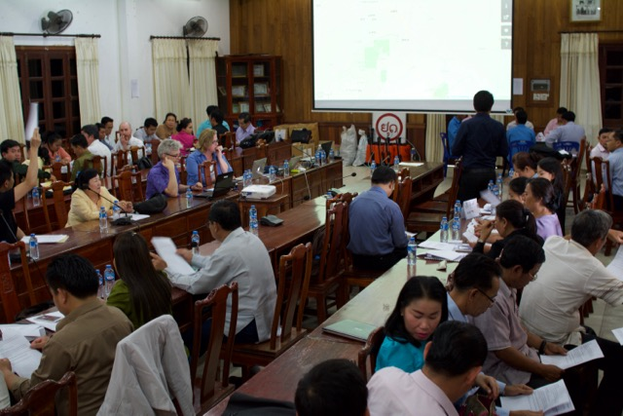
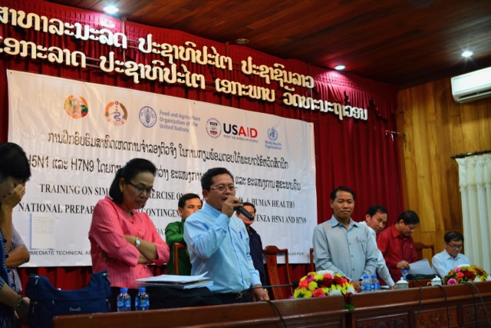
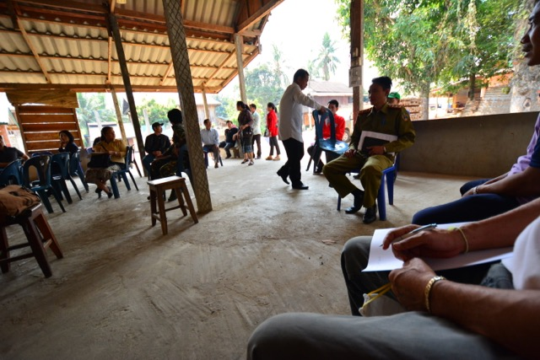
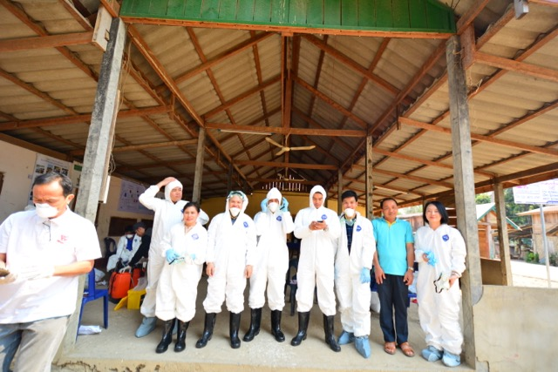
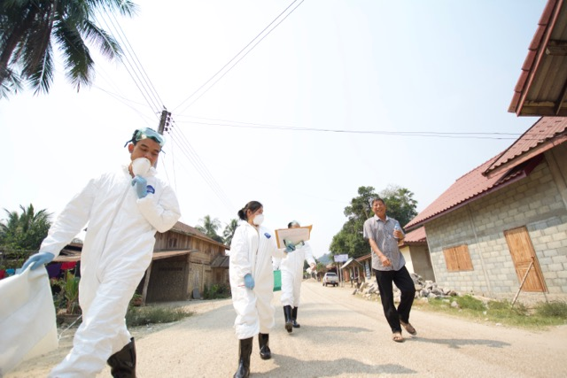
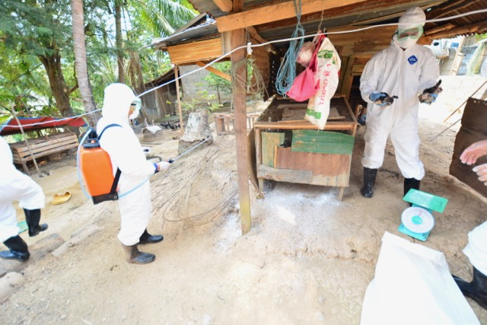
Join simulation exercise to test
Contingency Preparedness Plan – March 2017

Slide 38
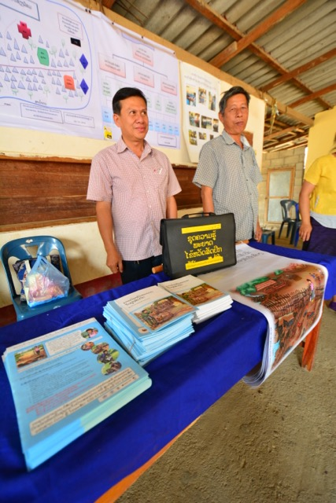
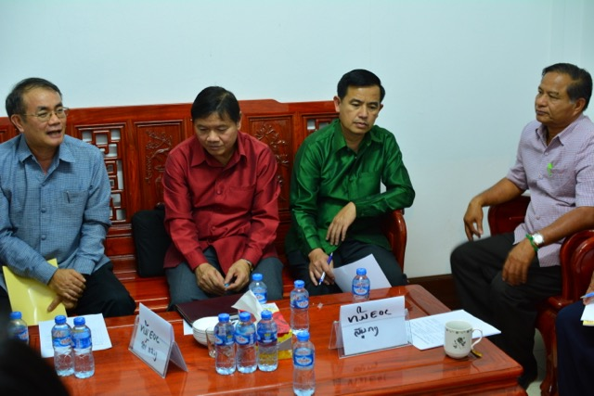
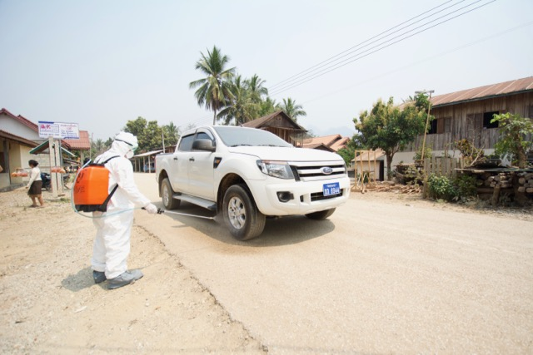
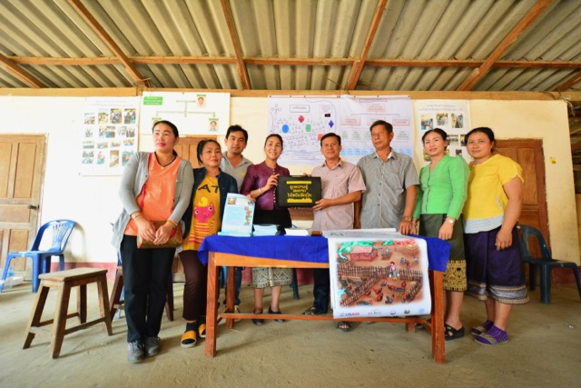
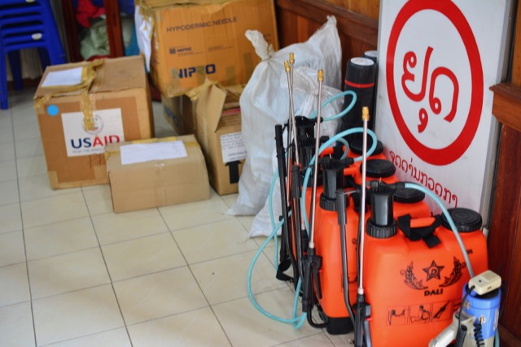
Join simulation exercise to test
Contingency Preparedness Plan – March 2017

Slide 39
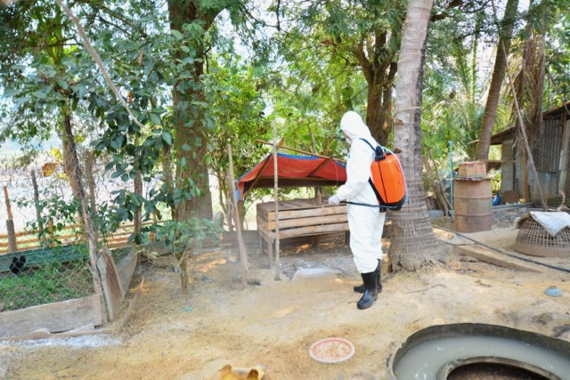
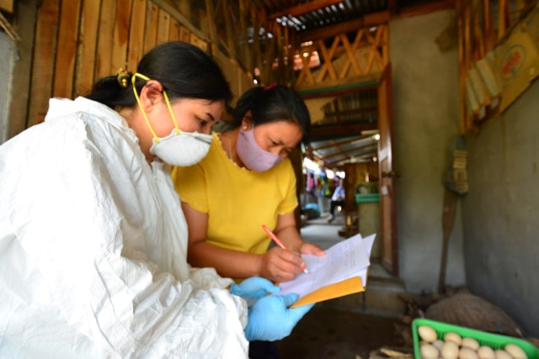
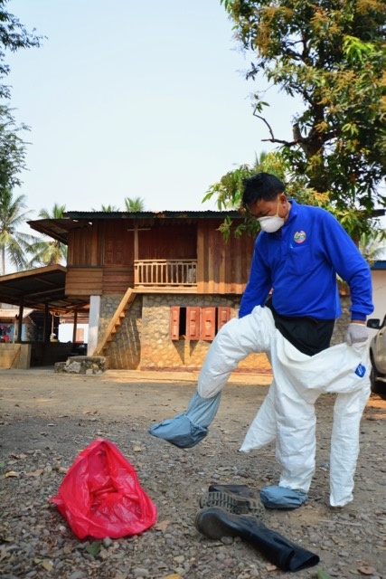
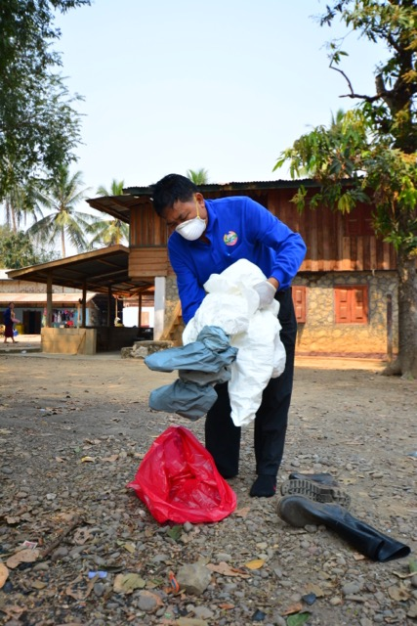
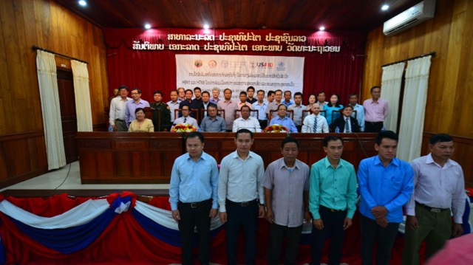
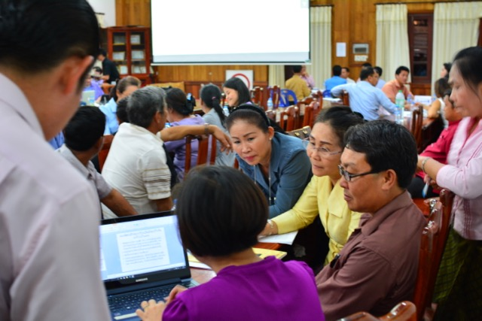
Join simulation exercise to test
Contingency Preparedness Plan – March 2017

Slide 40
Regional Preparedness
Regional GMS Network on Animal Health
Bilateral cross-border animal movement control
  Lao PDR - Thailand
  Lao PDR – Vietnam
  Lao PDR - China
Multilateral cross-border control of transboundary animal diseases for safer trade
  Lao PDR – China – Myanmar

Slide 41
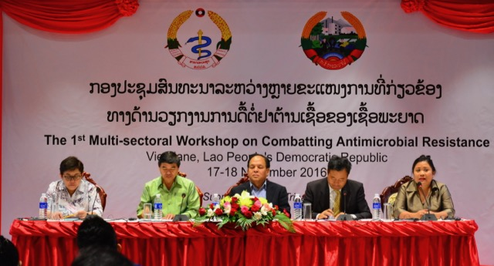
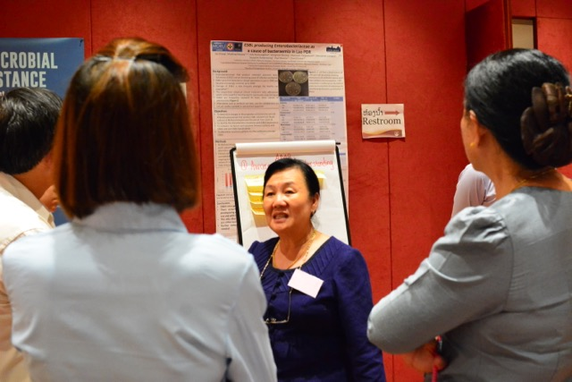

1st Multi-sectoral Workshop on Combatting Antimicrobial Resistance and National Action Plan Development November 17th and 18th, 2016

Slide 42
DLF continuing staff development
Training for DLF staff on Laboratory diagnostic at central and provincial level - one week course, 58 persons trained
Training for DLF staff on field epidemiology in action
  1 month course for 36 staff
  1 year course epidemiology and public health (2 persons/year total - 18 persons
  1 month course training at regional level for 7 staff
Training for rapid response team for outbreak response at different levels and Rapid Response Team (RRT) established at Provincial and District level
Training for PAFO and DAFO staff on outbreak investigation

Slide 43
Key Challenges
National legislation/policy and financial support for zoonosis disease control is limited in the short term and longer term
Insufficient Veterinary Science graduates in quality and quantity
Coordination Mechanism focused only two sectors (Health and Agriculture)
Unclear TOR for the Coordination Mechanism
Regulatory framework for AMR/AMU is still limited
Insufficient capacity at Border Checkpoints

Slide 44
Planned activities
Continue and accelerate initiatives to prepare and enact legislation that provides the legal framework
Review existing (and previous) multi-sectoral coordination mechanisms, including MOUs and the national list of priority zoonotic diseases, to identify practical and appropriate ways to implement existing policies.
Develop a national plan to increase the size of the animal health workforce in the public sector
Accelerate training of field veterinary epidemiologists for surveillance and outbreak response

Slide 45
Planned activities
Conduct a national inventory of dangerous pathogens stored in the National Animal Health Laboratory
Update laboratory-specific risk assessments as appropriate
Review (and develop) regulatory frameworks for appropriate management of antibiotic use in animals

