Slide 1



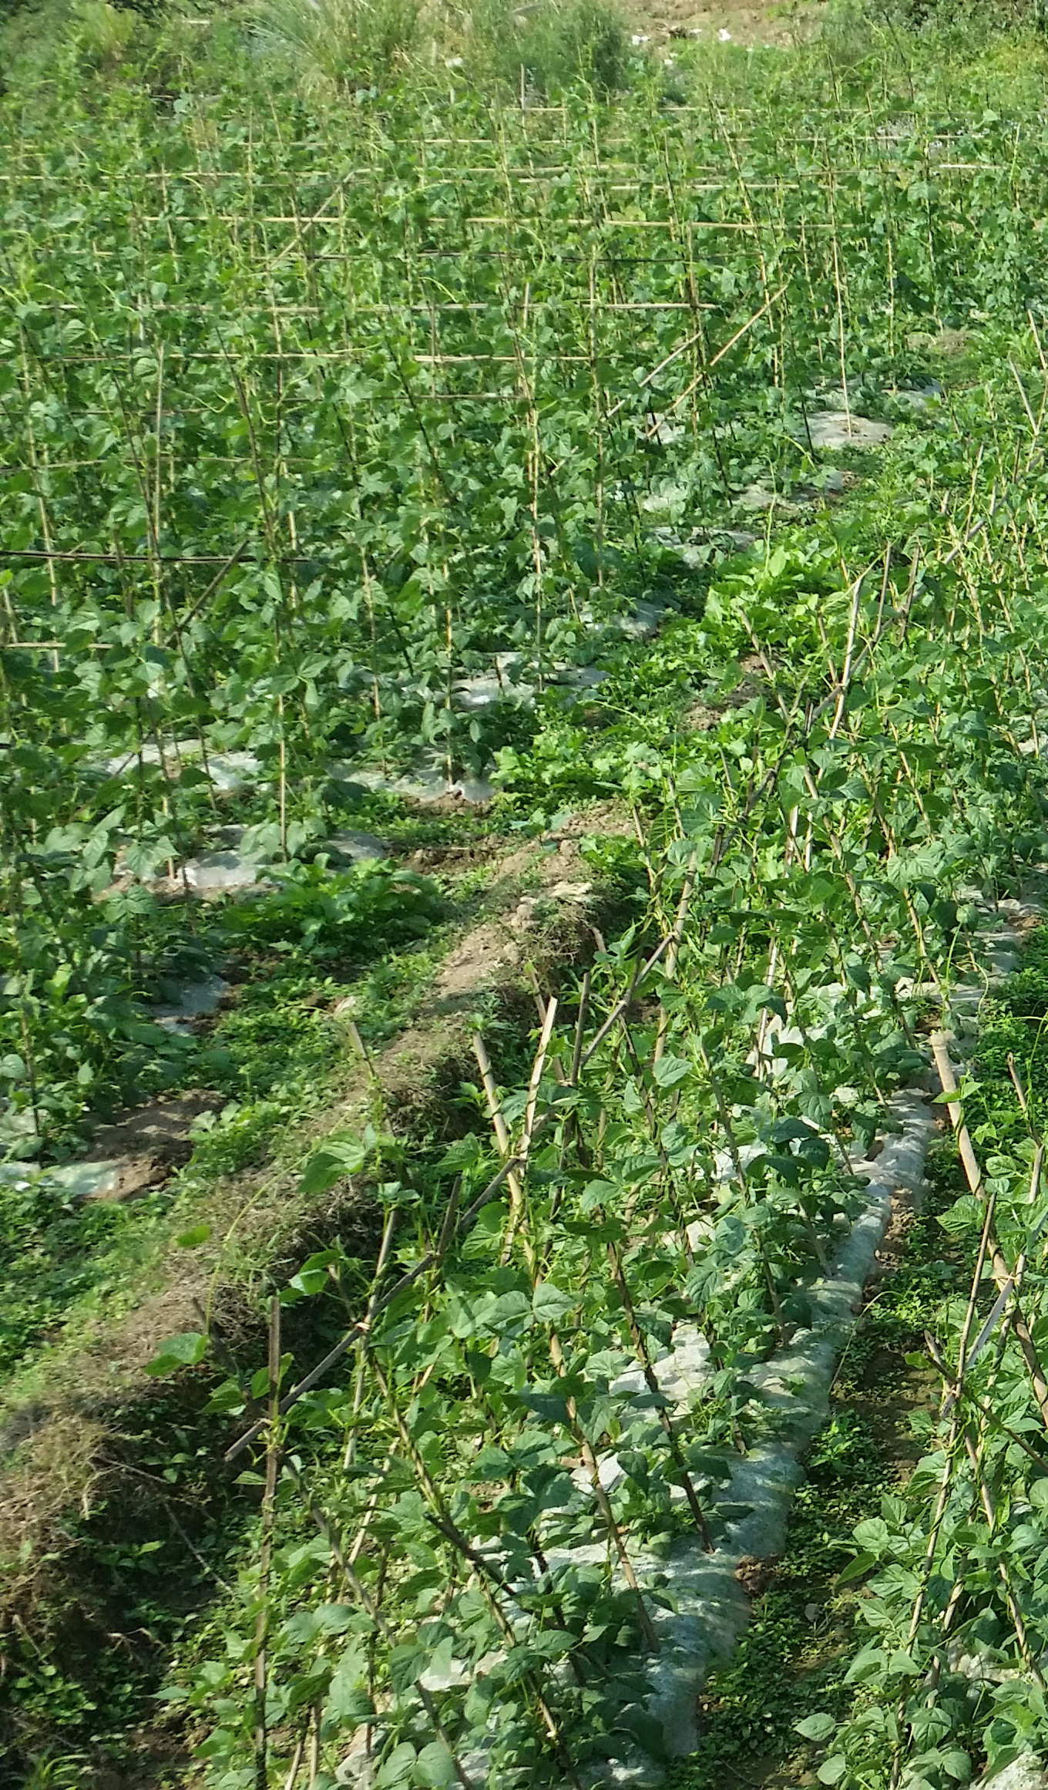
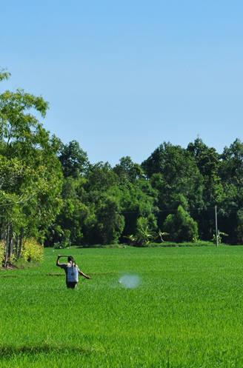
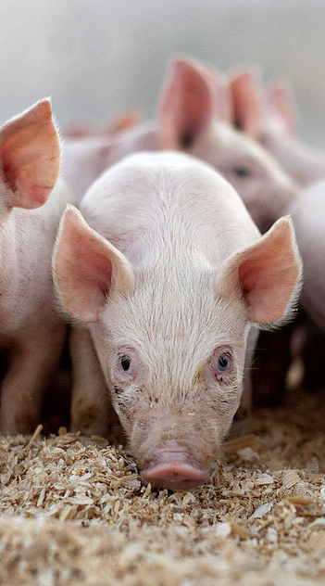
ANALYSIS OF CONTRACT FARMING IN LAOS
(green beans, rice & pig farming)
SWG-ARD Meeting
27 September 2017

Slide 2
Research team
Joint study between
PRC/NAFRI and CAP/IPSARD
CAP/IPSARD
PRC/NAFRI
Funded by IFAD

Slide 3
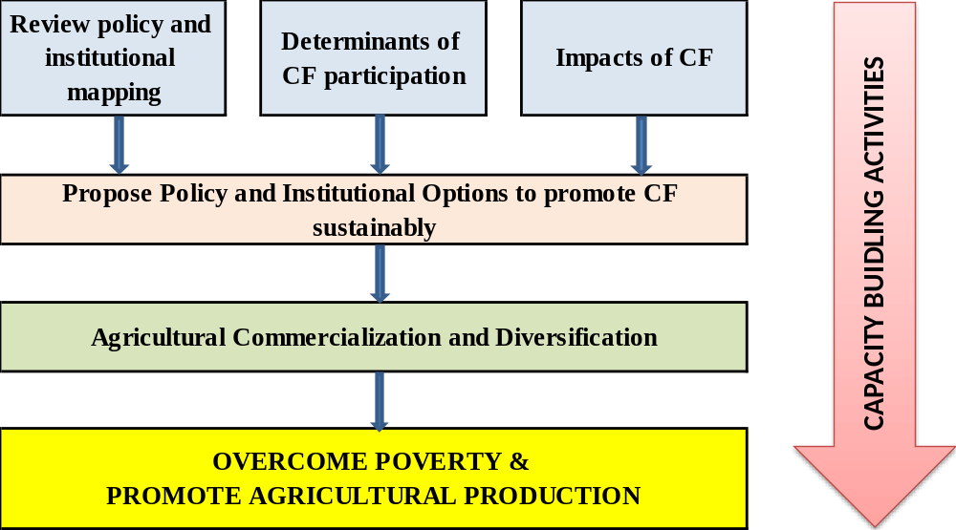
Research Objectives

Slide 4
Methodology
Desk review
Literature review
Policy review
Expert consultation
Data collection
Value chain survey
Household survey
Data analysis
Descriptive analysis
Empirical analysis
Writing of recommendations

Slide 5

Household survey
Sample size of survey
Household selection criteria
  CF and non-CF,
  Production scale,
  Economic status,
  Geographical location,
  Educational level,
  Male and Female.

Slide 6
Key Findings: Institutional Level

Slide 7
Policies related to contract farming
Contract Law (90)
Law on Property (90)
Law on Notary Offices (91)
Law on Agriculture (98)
Law on Environmental Protection (99)
Law on Processing Industry (99)
Amended Law on the Promotion of Foreign Investment (2004)
Law on the Promotion of Domestic Investment (2004)
Law on Judgment Enforcement (2004)
Law on Civil Procedure (2004)
Law on Enterprise (2005)
Law on Customs (2005)
Law on Secured Transactions (2005)
Law on Resolution of Economic Disputes (2005)
Law on Commercial Banks (2006)
Law on Labour (2006)
Decree on State Land Lease or Concession (2009)
Decree on Associations (2009)
Decree on Cooperatives (2010)
Agreement on establishment of Agriculture production group (2014)
Agreement on establishment of Agricultural Cooperative (2014)
The 5 year National Socio-Economic Development Plan VIII 2016-2020 (2015)
Agriculture Development Strategy 2016-2025 and vision 2030 (2015)
Policies are outdated and not specifically adapted to CF.
Lack of legal enforcement
1990-2000
2000-2005
2005-2010
2010-2015

Slide 8
Institutionalization of contract farming
6th National Economic-Social Development Plan (2006-2010)
  Focuses on the development of agriculture and the rural economy through the “promotion of commercial agriculture”
  Encourages FDI and land concessions, especially in horticulture and tree crops.
  Increasing Government concerns over the impacts of land concessions:
  2007: Prime Minister Bouasone Bouphavanh mentioned contract farming as the preferred alternative to concessions,
  Agriculture Development Strategy (ADS) 2016-2025 and vision to 2030 stresses “promoting CF” as one of its key policies.

Slide 9
CF Institutional Mapping
STATE
(Government, Parliament)
Central level
MAF
MoIC
MPI
MoJ
DAEC
Contract farming Unit
Land concession
Investment incentives
Notary Office
Court
Mediator Arbitrator
Business registration
Contract notification
Dispute resolution
Dispute resolution
Policy Formulation
Provincial level
PAFO
Local Offices
Business registration
Land concession
Investment incentives
Guidelines, Promotion
DAFO
Farmer connection, monitoring, contract notification and dispute arrangement
Farmer
Enterprises
Village Head

Slide 10
Many ministries are involved with CF
Many ministries are concerned by CF, yet no specific ministry was assigned to manage CF (MAF, MoJ, MIC)
  Overlaps and gaps in regulating and promoting CF
DAFOs have no clear mandate to develop CF or to oversee production agreements.
Weak public service provision (e.g., agricultural extension, CF guidance, market research and information) leads to an excessive dependence of farmers towards the private companies with which they are engaged in CF agreements. This makes them vulnerable to rent-seeking behavior.

Slide 11
Key Findings – Case studies

Slide 12
Determinants of CF participation
Products | Determinants
Green Bean | Farmers must be located in the company’s contracted area; Farmers must have land and stable irrigation source. Farmers are required to have enough labor (about 600m² of green beans require 2 workers)
Rice | Farmers with a good relationship with local authorities at commune or higher level High proportion of rice income in total income
Pig | Farmers with a good relationship with local authorities at commune or higher level Household witnessed reduction of pork price in the area

Slide 13
Success factors of CF
 | Internal factors | External factors
Green Bean | Trust / close relationships between companies and farmers. Open, transparent and precise contract arrangements Clear risk sharing mechanisms Clear contract enforcement (written contract) | Profitable market True farmer organization representatives Support from 3rd parties (e.g. local authorities)
Rice | Trust and openness in negotiation (EMRIP). Favorable CF arrangement for farmers: (guaranteed price) Slective participation by millers favoring farmer group members. | farmer groups helped raise the bargaining power of the farmers and protect farmers’ interests, the establishment of miller groups helped promote a ‘standard practice’ to ensure good feed to mills.
Pig | CF arrangement allows a fair sharing of risk for the farmers, clear selection process by CP, contract enforcement is stronger when written contracts are signed directly between the company and the farmers. | CP Group closely manages and controls the adoption of appropriate technology and innovation to ensure compliance with quality standards for the export market

Slide 14
Constraints

Slide 15
Lack of strong farmer groups
Rice and green bean sectors: the presence of farmer groups contributes a lot to the success of CF, by raising the bargaining power of the farmers and by protecting farmers’ interests. However, this is mainly true if the group leader is selected by the farmer themselves.
In 2016, only three cooperatives were registered in the whole country, which can be attributed to the relative newness of the laws, to the lack of uniﬁed implementation, and to the lack of information, skills, and practical experience among both farmers and the government.
No clear incentive policies for farmers and farmer groups to participate in CF in Laos.

Slide 16
Lack of domestic enterprises
Domestic agribusinesses are few, small and weak, leading to the domination of foreign investors on the market.
This may lead to a situation where a small number of domestic and foreign enterprises enjoy a near-monopoly position.
This might be dangerous for smallholder farmers, especially if they are not organized in groups.
Private companies are not aware of the benefits they may get from engaging in CF (tax exemption to import inputs). There are no clear and comprehensive incentive policies for CF enterprises.

Slide 17
Weak control of agricultural markets
No prospective analysis about agricultural markets and market trends.
  Laos has trouble meeting the demanding market for commercial production.
  Fierce competition from neighboring countries (China, Thailand, Vietnam) on export markets. However, CF rice was exported to China.
  Limited management capacity of agricultural markets reduces the ability of farmers to supply the market.
  lack of proper documentation for border crossing → no exports,
  poor market information provision → wrong choice of crop
  infrastructure facilities to link farmers to market (e.g., wholesaler markets, transportation, storage) → higher costs.

Slide 18
Positive impacts on incomes
Green Bean | Rice | Pig
CF created employment for the farmers in the dry season, thus improving farmers’ incomes. CF helped double: total income (from 6.3 million LAK/year to 13.4 million LAK/year) income per capita (from 1.3 to 2.9 million LAK/person/year). | Rice income per capita increased: by 382,000 LAK for CF households; by 159,000 LAK for non-CF households. | Due to a continuous decline in pork prices over the past years, farmer incomes from pig production have been falling. Income reduction was lower for CF households: non-CF household incomes fell from 21.8 million LAK/year to only 12.6 million LAK/year (-42%) CF households suffered from a much lower reduction (-16%) and their absolute income from pig production was much higher than non CF households.

Slide 19
Other positive impacts of CF
CF offers more opportunities to farmers:
  CF led by agribusinesses with close links to the market offers farmers new opportunities to seize.
  CF creates better access to technology through the company.
CF improves market access
  CF as a way to target export markets (Viet Nam, Thailand, China)
  Rice: more balanced between export and domestic consumption.
  Green bean: all of the production is for the Chinese market.
  Pig: focuses totally on increasingly demanding domestic market.
Risk sharing for farmers
  Risks: natural disaster (drought, flood, frost), disease outbreak or price risk
  CF help attract investment in agriculture, especially foreign investors

Slide 20
Negative impacts of CF
Bias towards large farmers and risk of squeezing out small farmers
  Not all farmers can participate into CF: farmers who are inefficient and/or not competitive enough risk being eliminated.
  In a country with many smallholder farmers, a high social and political risk may be associated with such exclusion. Therefore, the process of up-scaling and its trade-offs should be cautiously considered.
CF may lead to monopolies/oligopolies due to rent-seeking behaviors and the small number of domestic stakeholders.
Rent-seeking behaviors may arise among various categories of stakeholders:
  farmer group representatives who were not elected by the farmers and received commission from the millers.

Slide 21
Recommendations
Improve policy and legal framework for CF
Improve institutional arrangement
Promote farmer organization development
Promote the development of domestic enterprises
Improve agricultural market management
Promote social values and utilize community-based mechanism for effective contract enforcement

Slide 22
Improve policy & legal framework for CF
GoL should consider writing a specific chapter on CF in the current Law of Contract.
MAF needs to develop a separate package of legal documents on CF, which should include (but not be limited to):
  Regulations on CF concept, definition, and models which are close to reality.
  CF templates for each model, contract clauses, rights and obligations of the parties in technical and financial terms, contract management and valuation methods.
  Regulations on CF enforcement to increase the transaction cost of breaking contract for the parties. The disputes settlement mechanism should also be simplified and promote third-party mediation at the local level.
  Incentive policies for CF development (e.g., land, credit, bank interest, tax, input cost, extension, trade promotion, technical training).
Based on the legal documents, MAF develops simple and user-friendly guidelines for contract parties and local authorities.

Slide 23
Improve institutional arrangements
MAF proposes to the Government of Laos to clarify the role of the different ministries regarding CF;
MAF evaluates the implementation of CF promotion at all management levels (MAF, Departments, PAFO, DAFO);
MAF reviews related development agencies working on CF
MAF builds capacity for officers; and improves treatment system for officers based on performance evaluated by users (farmers);
MAF cooperates with provincial authorities to carry out a needs assessment of CF parties aimed at understanding what public services should be provided;
MAF proposes to design mechanisms and incentive policies to attract private sector to participate in service provision to CF parties, especially legal supports.
Notes:
MAF proposes to Laos’ Government to clarify the role of ministries in CF. MAF should take the leading and focal role to promote CF and provide public services on CF. Other ministries cooperate with MAF in relevant issues.
MAF evaluates the CF unit under the DAEC and build its capacity to focus on policy and guidelines formulation to promote CF.
MAF cooperates with provincial authority to do the needs assessment of CF parties to understand what public services should be provided such as market information, legal supports, etc. Assess the role and capacity of DAFO in providing public services for CF parties, based on that identify clearly the role of DAFO and build its capacity or establish a separate professional unit to provide CF public services.
MAF reforms its state S&T and extension units into self-financed and autonomous status; build capacity for officers; and improve treatment system for officers based on performance evaluated by users (farmers). This helps create incentives for the system to work more efficiently and respect the interests of the farmers, hence, contributes to minimize rent seeking behavior.
At the same time, MAF proposes to create mechanism and incentive policies to allow and attract private sector to participate in such service provision to CF parties, especially legal supports.

Slide 24
Promote farmer organizations
MAF builds capacity of the DAEC to promote the bottom-up implementation of the Decree on Association No. 115/PM, in 2009 and Decree on Cooperatives No. 136/PM, 2010.
DRDC should follow MAF’s policies on the Establishment of Agricultural Cooperatives and the Establishment of Agriculture Production Groups
DRDC reviews good CF farmer group and cooperative models in Laos and other countries such as Vietnam, Thailand, and China, and upscale in Laos’ conditions in periods.
DRDC supports capacity building for farmer groups and cooperatives in legal regulations for CF negotiation, signing, implementation and disputes mediation.
Notes:
MAF builds capacity of the DAEC to promote the bottom-up implementation of the Agreement on establishment of Agriculture production groups and the Decree on Cooperatives 2010.
DAEC assesses the implementation of the following Government’s policies to promote sustainable cooperatives stated in the Decree of Cooperatives, which are still general, and translate them into specific incentives for cooperatives and farmer groups when engaging in CF:
Create conditions for the cooperative to be competitive and have access to the market
Create conditions for assisting cooperative in capital, credits, providing land, tax incentives, providing and promoting use of new technology and sciences.
Develop necessary infrastructures and human resources
Advertise and help to find the access to national and international markets.
Promote and create conditions for cooperatives in order to contribute in implementation of Government’s Social-Economic Development Plan, particularly alleviation of poverty.
Praise and give prizes to outstanding cooperative or its members
Ensure the equality before the law among the cooperatives in business operations.
Promote relation and cooperation of cooperative with foreign countries and International Organizations in exchanging mutual experiences and lessons and technology, and capacity building in cooperative management
Cooperative operates its business activities under management and assistance of authority concerned.
DAEC reviews good CF farmer group and cooperative models in Laos and other countries such as Vietnam, Thailand, and China, and upscale in Laos’ conditions.
DAEC supports capacity building for farmer groups and cooperatives in management, technical farming, and legal regulations for CF negotiation, signing, implementation and disputes mediation.

Slide 25
Promote the development of domestic enterprises
MAF cooperates with other ministries:
  to review the implementation and to assess impacts of current incentive policies aimed at attracting domestic private investment in agriculture,
        Law on the Promotion of Domestic Investment providing duties and tax incentives to investment in the agriculture or forestry sectors, manufacturing activities in agriculture and forestry.
  to propose policy supplementation and amendments to encourage private investment in agriculture and the involvement of private investors in CF.
  to study and to recommend policies to support and promote agribusiness incubation, capacity building for start-up agribusinesses and their involvement in CF.
MAF builds capacity for domestic agribusinesses to work with the farmers on CF negotiation, signing, implementation and dispute mediation.

Slide 26
Improve agricultural market management
MAF identifies strategic agricultural commodities and markets.
MAF cooperates with MoIC:
  to promote trade and investment promotion activities to improve access to markets for CF products and to attract a variety of investors,
  to formalize and to improve the management of cross-border trade.
MAF improves market and commodity research.
MAF provides market information to stakeholders, especially via affordable facilities (e.g., mobile phones, internet) to improve the bargaining power of farmers in CF.

Slide 27
Promote social values and use community-based mechanism
MAF organizes regular awareness and communication campaigns on CF and CF enforcement for farmers through training courses, central and local media, local officers and farmer organization leaders, etc.
MAF cooperates with MARD/Vietnam to consolidate the Strategy on agriculture, farmers and rural areas (Tam Nong Strategy) submitted to Laos Government for approval.
Notes:
MAF organizes regular awareness and communication campaign on CF and CF enforcement for farmers through training courses, central and local media, local officers and farmer organization leaders, etc.
MAF cooperates with MARD/Vietnam to consolidate the Strategy on agriculture, farmers and rural areas (so called Tam Nong strategy) submitted to Laos Government for approval. Rural development is one of the three crucial pillars of the strategy which should focus on preserving and promoting rural community, relationship, traditional values and norms; encouraging the self-autonomy spirit; and mobilizing internal social assets of farmers for development.
Once the Tam Nong Strategy is approved, MAF reviews and formulates a package of policies for rural development; develops M&E framework and tools, where CF may be one of the criteria.
Lao’s government finalizes moving the rural development mandate to MAF (currently belong to the National Committee on rural development and poverty reduction). MAF consolidates and builds capacity for this unit.

Slide 28
THANK YOU!

