Slide 1
Nutrition Sensitive Agriculture
Presentation delivered to the SWG-ARD
27 September 2017
By the MAF NSA Committee

Slide 2
Overview
Context
MAF’s work to address the nutrition challenge
NSA Study Results
Harmonized NSA Framework and sub-national Planning

Slide 3
Farming community orientations in Laos
Lao farming communities fall into three broad categories:
  Subsistence—declining, but still substantial
  Mixed (not just transition)—most prevalent
  Market-oriented (commercial)—growing percent
Each faces unique challenges for meeting nutrition needs, and each needs distinct NSA services
Subsistence farming communities have the highest prevalence of under-nutrition
(proxy = rural and road access)
Residence | Children under five who are stunted (from 2011/12 LSIS)
Rural | 48.6 %
Rural with road | 47.8 %
Rural w/out road | 53.8 %
Compare with urban | 27.4 %

Slide 4
Commercialization of agriculture
Throughout the country (North, Middle, South)
Commercialization increases income, but…
  No practice of purchasing nutritious foods
  No place in which to buy nutritious foods
  Time demands, especially on women, limit gathering, nutritious food production
  Commercial farming takes up the best land/water; land use challenges
Transitional state means neither subsistence farming nor markets provide consistent access to nutritious foods at this time
In short, commercial farming disrupts traditional NSA strategies and coping mechanisms and doesn’t quickly replace them with a viable alternative.

Slide 5
Agriculture is central to the solution
Substantial success in securing rice production to meet national needs, since early 2000s
Growing sector income by three to four percent annually
Farmers produce the foods our communities (both farming and urban) rely on for nutrition
Recognized in the four agriculture interventions within the National Nutrition Strategy & Plan of Action (NNS-PA)

Slide 6
NSA Projects
More than twenty projects (ODA-funded) directly support NSA
With more than 130 million USD committed
Two modalities
  Government-managed
  INGO-managed
However, only 50+ districts (out of 148) covered, leaving many districts without support for NSA
Opportunity to develop and test models, but needs to be upscale-able by GOL: DAFO

Slide 7
MAF’s work to address nutrition challenges
‘Improve local production of healthy, diverse food for local consumption’
Support better coordination—planning, M&E, collaboration—of the (4) agriculture NNS-PA interventions
Improving evidence-based planning, reporting, and mapping
Improve Sub-national (PAFO and DAFO) delivery and coordination
Refine and capitalize good NSA practices—guidelines, studies
Learning exchange networks: peer-to-peer and farmer-to-farmer.

Slide 8
MAF: Nutrition Sensitive Agriculture Committee
Convergent Ministries
MAF NSA Committee
Chair: Dr. Bounkhuang
NSA Secretariat
Chair: Mr. Savanh
PA1: Vegetables
DoA
PA3: Processing
DTEAP
PA4: NTFP for Food & Income
DoLMD & DoF
NSA Tech Team
All tech. depts.
PA2: Animals & Fish
DoL
NNC; MoH; MoES
Community of Practice
NSA Projects
NAFRI
DP / Project
DP / Project
DP / Project
DP / Project

Slide 9



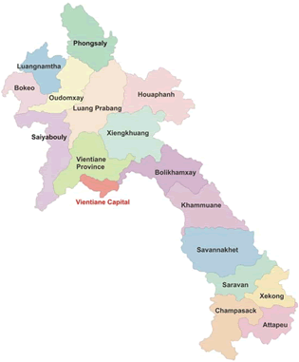



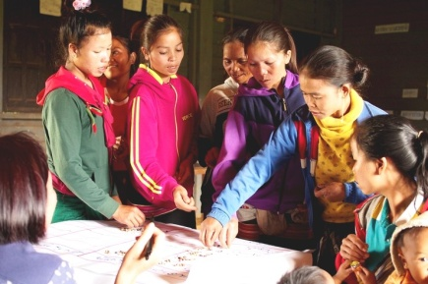
Taking stock of current experiences: NSA Study
Background:
MAF/Helvetas team, guided by FAO
28 organizations using NSA (Government, Development Partners, CSOs)
Methodology:
Consultation with 28 projects
4 case studies: interviewed service providers and participating villagers: 8 women’s & 8 men’s groups, 64 HH, in 8 villages
1: SSSJ Soum Son Seun Jai, IFAD/ LuxDev/WFP/GIZ, Pakbeng, Oudomxay
3: Helvetas-UDIN Helvetas/EU, Integrated Upland Development in Nonghet, Xiengkhouang
2: LONG/PRF/WB Poverty Reduction Fund/World Bank, Livelihoods Opportunities and Nutrition Gains Project, Hiem, Huaphan
Four
cases
4: CARE-DFSP CARE/EU/Lux-Dakcheung Food Security project, Sekong

Slide 10
A) Technical: NSA Intervention success stories
Intervention | No. Projects | No. HHs | Destination | Comments & Limitations
Home gardens | 4/4 | 1,128 | Eaten and Sold | + Enthusiasm among participants in Sekong: women sell vegetables for 3 million kip/HH/yr. -If seed is provided, not sustainable -Production is mostly seasonal (4 months/year) -Access to water is difficult -limited impact on consumption patterns
Fruit trees | 4/4 | 796 | Mostly Eaten; Some Sold | -3-10 trees/HH -intake still insufficient -low local buying power -foreign market competition
Fish ponds | 4/4 | 462 | Mostly Eaten; Some Sold | -Yields usually low (e.g. 5 g/pp/day) -Limited viable locations (water access) -Input challenges fish fingerlings; Need to consider other aquatic animals and specific techniques
Fish Conversation Zones | 2/4 | 760 | Mostly Eaten; Some Sold | -Only viable in some locations -Limited yields -Difficult to measure

Slide 11

A) Technical: NSA Challenges
Intervention | Problem | Cause | Opportunities
Nutrient-rich crops (e.g. beans) | -Little plant protein consumed—complicating efforts to address protein deficiency | -People unused to eating -No recipes -Low price/no market | +Intercropping tried (limited success) +Time savings technologies +Safe production practices
Small livestock (e.g. poultry, goats) | -High livestock mortality in traditional systems -Product often sold (not eaten) -voluntary vet schemes not sustainable | -Women have too little time to look after animals -Seen as financial asset not food | +Demonstrated successes (from other projects) with intensified, small-scale production for local markets; some product eaten +Alternative animals and insects
Processing and storage | -Hardly any nutritious foods stored | -Lack of proven models -Little experience / acceptability | Extend seasonal availability: +Drying, powders, pickling +Mushrooms, fish, vegetables
Linking NRM to nutrition | -Insecure access / use of wild foods | -Unclear forest management rules -Pressures to convert land to other purposes | +Various land-use management approaches (though expensive) +Community forest management

Slide 12

B) Role of women in a Commercializing Sector
Women DRIVE HH-level NSA
Increased work-loads of women—a strong impact of commercialization—undermine NSA
Empowered women are more able to pursue HH nutrition (behaviour change)
NSA programmes with a women-centred strategy made the most impact:
Empower women to plan (WINGs)
Village Women planning council for all project decisions
Reduce workloads to spend time on child caring
(Still no success found here)
Create women’s learning and cooking groups:
Potential to be cooperative child-care and support

Slide 13
C) Underlying Factors: landscape, ethnicity, poverty, wealth, access
1) Poverty and Lack of Food Security
2) Wild Foods
Poor, remote communities face different challenges than market-connected ones
Most lack information
If families lack sufficient rice, they are not easily engaged in discussion of dietary diversity
Addressing rice sufficiency appears an important precursor to addressing dietary diversity.
Wild foods still constitute important part of diets: up to 30% of food in many villages
Forests and rivers are important source of food in non-vegetable-producing seasons
Forests and rivers: risk management / coping strategy
Accessing forest is increasingly time demanding (more remote)
Few examples found of successful engagement.
LESSON: Differences in landscape, ethnicity, access, wealth, require various approaches (one size does not fit all)

Slide 14
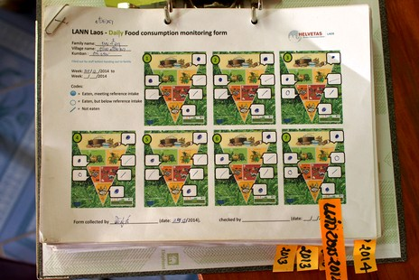

D) Convergence
E) M&E - Indicators
Elusive evidence on outcomes of NSA
Impact Pathways of NSA seldom defined or monitored
Conclusion: M&E of NSA should follow pathways:
a) Diverse food production
b) Availability and Access to food
c) dietary diversity
d) nutrition status (convergent approach)
Little indication agriculture activities in isolation changed nutrition
Women reported most significant changes in behaviour from awareness raising (SBCC)
Conclusion: NSA needs to be embedded within a locally-planned nutrition approach that fosters ownership (e.g. LANN / Farmer Nutrition Schools)

Slide 15
Need for a more harmonized framework
Facilitate mobilization & coordination of extension services
  Overcome hesitation and build on the experience nation-wide experience (DAFO)
  Fit NSA within a convergent approach
Frame objectives and expected outcomes
  With specific, tangible wording for indicators
  To shape impactful services
To enable consistent data collection
  That will facilitate monitoring, evaluation, and support
  To gain stronger evidence of the impact of agriculture on nutrition in Laos

Slide 16
Impact Pathways for NSA in Lao
Developed in consultation with the NSA Community of Practice
In-direct
Change
Consumption of
Diverse, Nutritious Food
Convergent Actions:
--SBCC
--Education
--Fortification
--Nutrition Coaching
--Farmer Nutrition Schools / Learning groups
Direct
Change
Women’s
Income (Access)
Food
Availability
Processing & Marketing
Farmer
Actions
Extended availability
Safety and efficiency
Production
Gathering
Vegetable/ Crops
Animal Protein
Land
Forests
Water
This is the soft line, crossed through convergent programming; clarifies that to reach the higher impact goals requires multi-sectoral programming. NSA, to be successful, must sit within broader actions.
Disease prevention/treatment
Input supply systems
Sustainable Land/Forest/Water management
Depending on local conditions
Agriculture
Interventions
NSA Plans
Knowledge Innovation
Systems
Feed production
And others

Slide 17
MAF NSA Data Collection System: three reporting lines
MAF-DOPF (NSA Committee)
PAFO
Technical Departments
NSA Projects
DAFO
Project progress, investment and impact data
District-by-district implementation progress data
Investment and progress on national projects

Slide 18
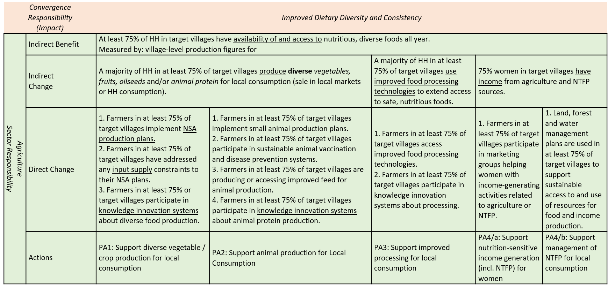
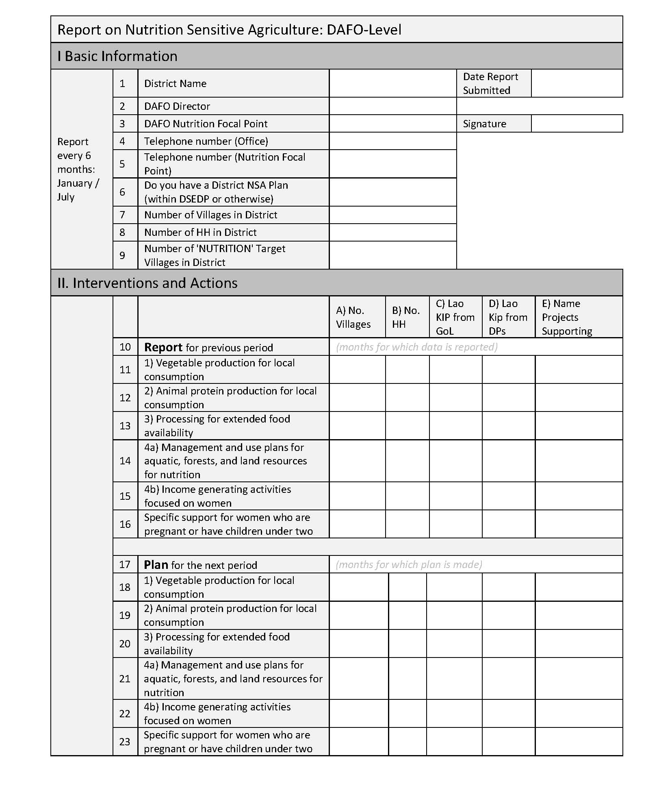
MAF NSA Data Collection System: elements
Developed by MAF NSA Committee with support from the NSA community of practice
Indicators at three levels of change, for use by stakeholders in project design & M&E
Data collection form & guidelines to allow DAFO-PAFO to report on NSA progress, for use by projects and DAFO, consolidated centrally by MAF NSA Committee

Slide 19
Sub-national NSA Planning Support
MAF will pilot a new approach to NSA Planning
  To enable evidence-based decision-making
  To Balance Commercialization and NSA
  Incorporates P-CAP and PROMIS
  To coordinate and link with project-based plans (not to supersede)
  To fit NSA within multi-sector plans (DSEDP)
Planning targets
  Pilot in three Provinces in 2017
  Support role out in priority provinces/districts in 2018
M&E Targets:
  Implement improved data collection in at least seven provinces, 2 districts/province
  To target and implement with support from NSA projects.

Slide 20
Conclusion
Agriculture remains the bed-rock of solving Laos’ nutrition challenge
We have, collectively, technical solutions to production problems
Challenges remain, especially in processing and supporting NRM
Effective solutions will come through multi-sector coordination
Collaboration requires agriculture to have a clear understanding of its own place and impact pathways
Plans, monitoring, and reporting need to balance NSA with commercialization
The community of practice—GoL, DPs, Civil Society, Private Sector—supporting learning and improvement, is key to our success.

