Slide 1
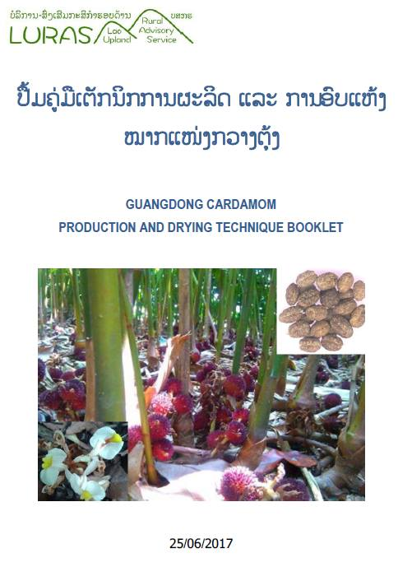
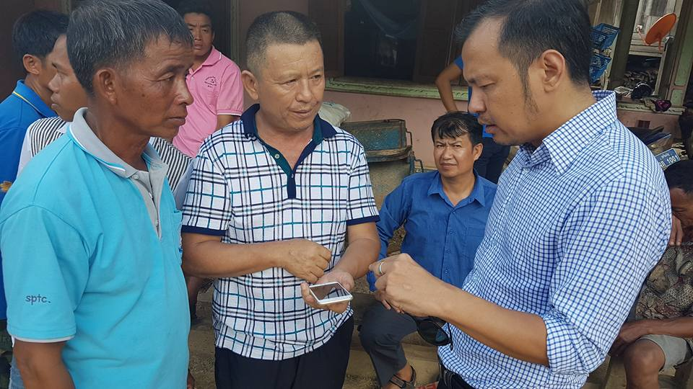
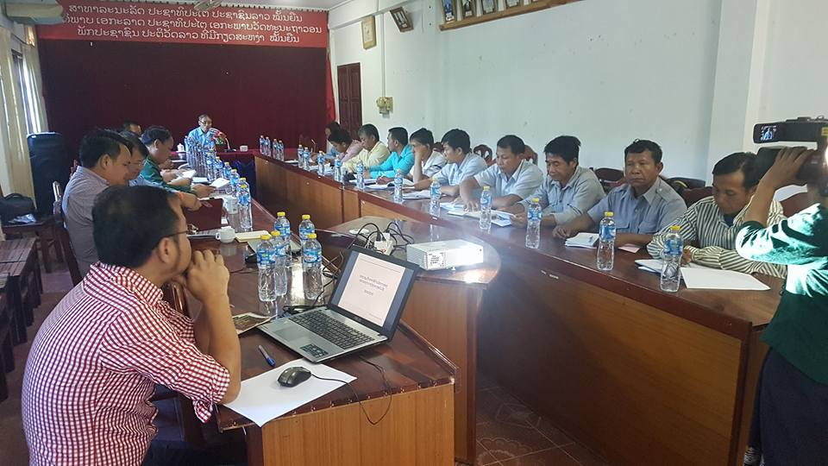
SSWG Farmers and Agribusiness:
Contributions to the RTIM Report (2017)

Slide 2
Action relating to the RTM/RTIM points
Type of action
4.02 The SSWG is providing a platform for the voice of small producers
4.03 Commissioning and disseminating value chain studies
4.04 Sharing data about pesticide use, contamination of the food system, and cases of sustainable agriculture.
Examples/Details
... Representatives of Lao Farmer Network make presentations at SSWG meetings
... 130 VC reports in repository. Latest on Cardamom; recommen-dations now being implemented
... Presentations at national and international meetings. Pesticide Briefing Note being updated.

Slide 3
Action relating to the RTM/RTIM points
Type of action
5.02 Sharing of studies and guidelines for strengthening farmer organisations (FOs) and promoting rural entrepreneurship
7.08 Dissemination of nutrition training and extension materials
9.08 In collaboration with LIWG, SSWG members have produced guidelines for partnerships with private sector
Examples/Details
... A series of guides for FOs produced by DTEAP will be launched at next SSWG meet
... NSA extension booklets already available from DTEAP
... See 'Voluntary Commitments for Responsible Agribusiness in Lao PDR'

Slide 4
Challenges and Responses
Challenge
Growing concerns regarding food safety could affect agricultural trade in addition to health of domestic producers and consumers.
The issue of rural youth has also moved onto the agenda for this SSWG. Agribusiness should involve job creation, not just commodity production.
Response
... the SSWG will give more attention to capitalizing experience with agro-processing, testing and certification.
... the role of SMEs and entrepreneurship in the sector deserves more attention.

Slide 5
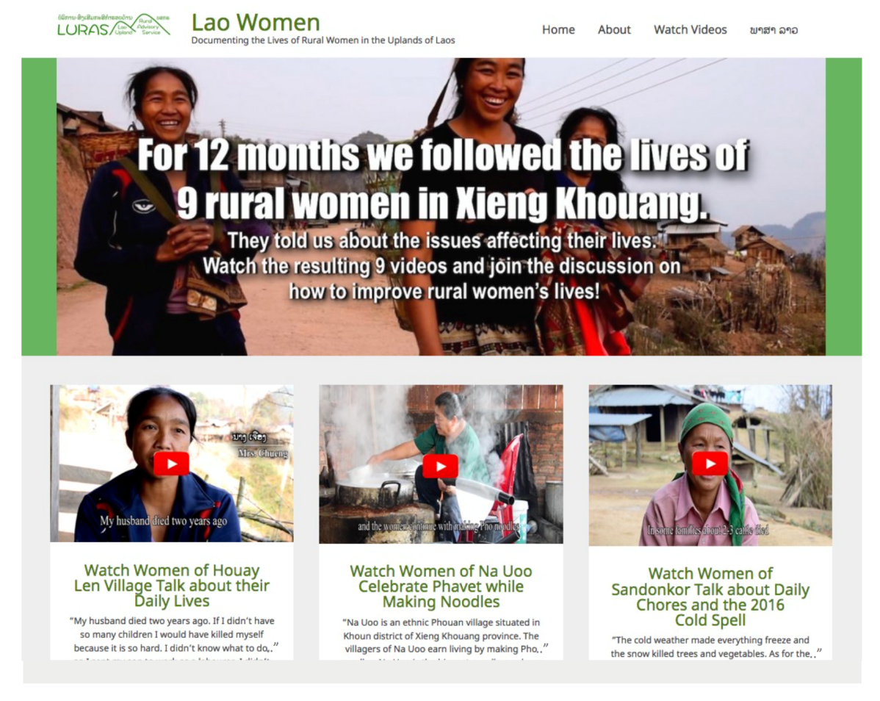
Communication and outreach activities
Progress
SSWG-FAB supports the biggest online information services for development workers in Laos
LaoFAB has 4,450 members who posted 1,376 message in the past 12 mths and uploaded 354 documents to the repository, making a total of 2,972 files
Meanwhile, Lao44.org has 2,456 files in Lao language, including videos and reports. The most popular of which has been viewed more than 2,000 times.
Announcement

