Slide 1
SSWG
Rural Development

Slide 2
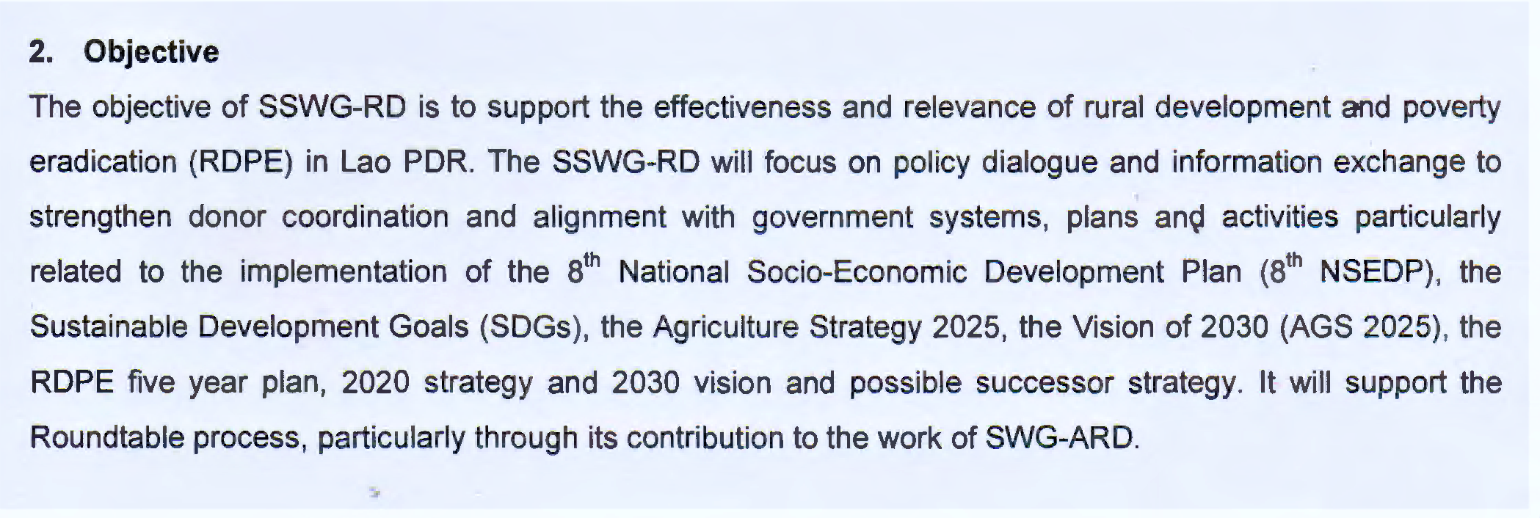

Slide 3
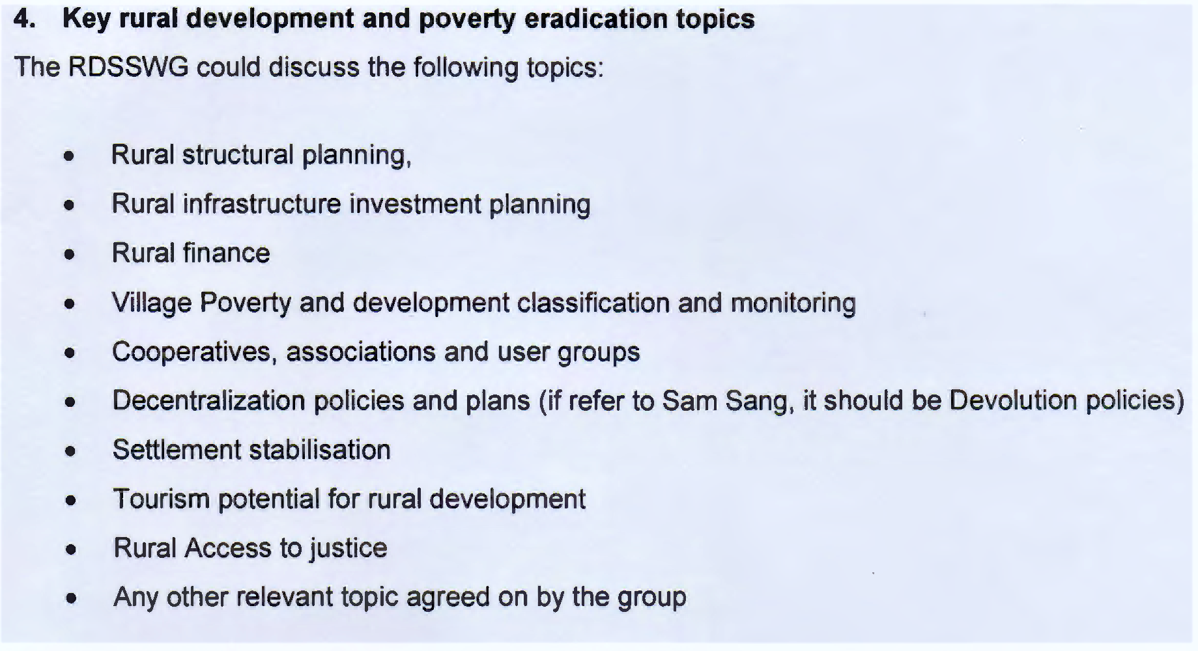

Slide 4
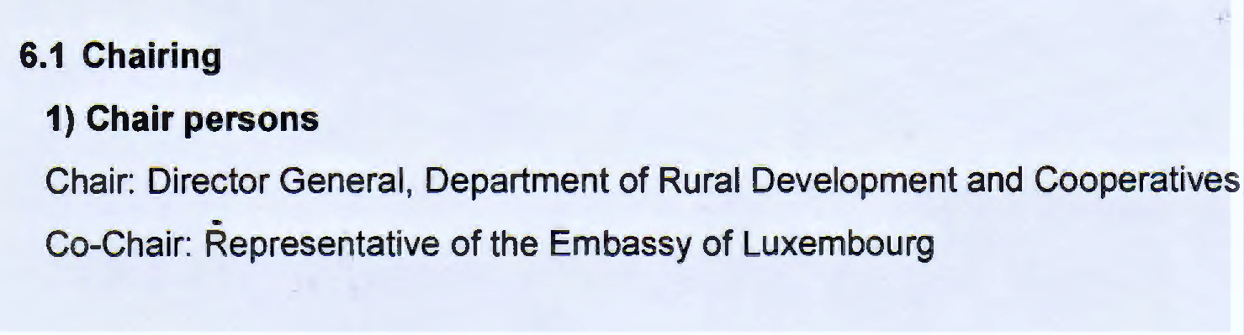

Slide 5
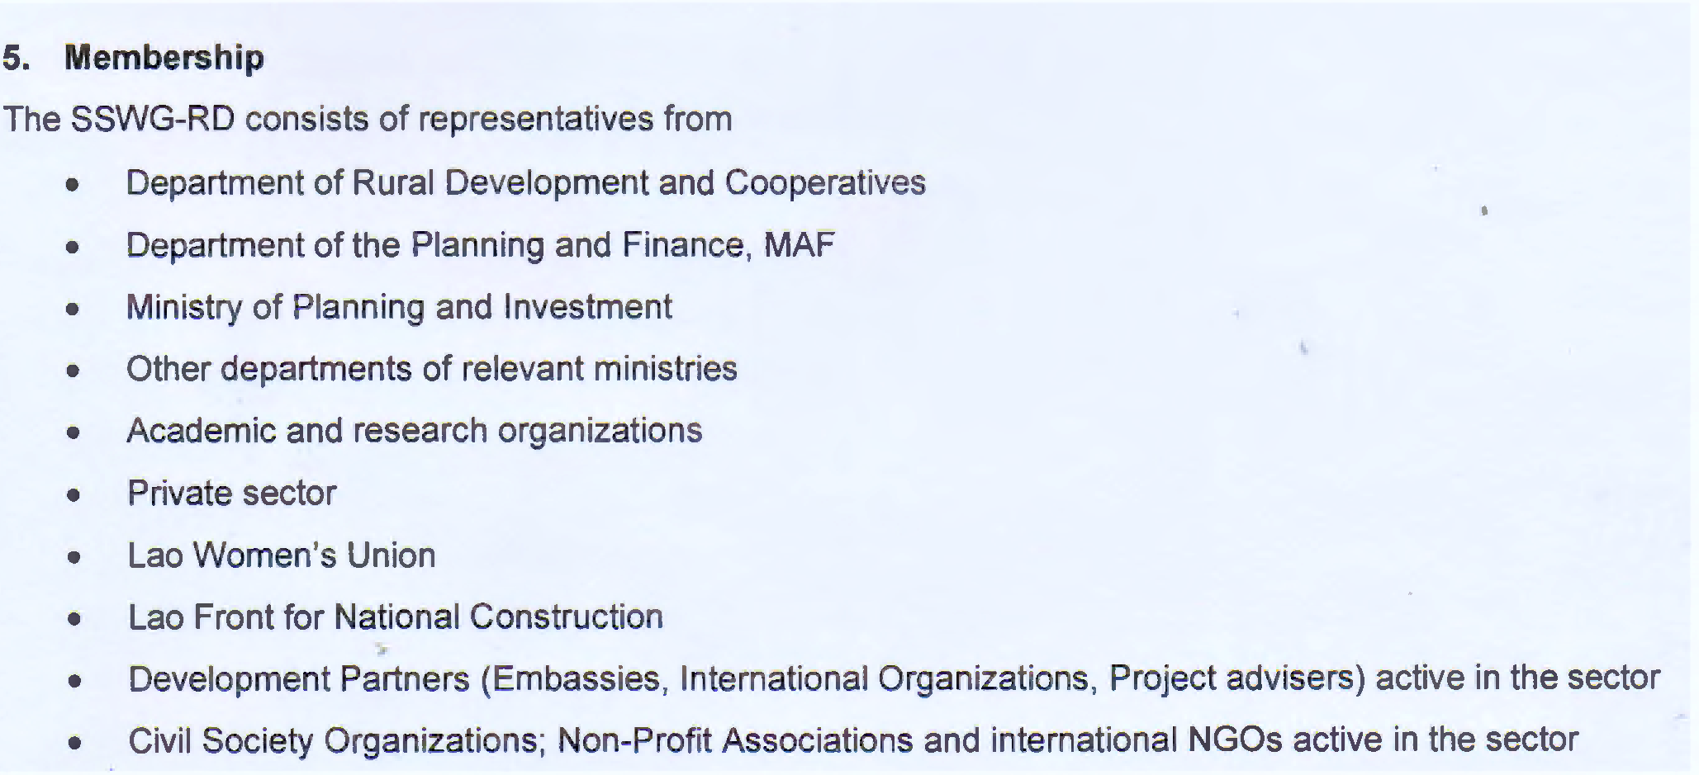

Slide 6
Well-being criteria
Lao PDR

Slide 7
: Well-Being Criteria
Non-poor family:
Durable and safe shelter.
Adequate assets and housewares/ equipment for the basic utilization and living earning.
Adequate labor for generating stable income
Basic education
Clean water and sustainable energy
Accessible to basic public services

Slide 8
: Well-Being Criteria
Non-poor family:
Consumption based-criteria.
Assets and comfort.
Dependence ratio
Basic needs satisfied
Facilities accessibility

Slide 9
: Methodology
National committee RDPE - LSB – WB
-Consultation: (LECS)# P&D Criteria(309/pm)
poverty measurement # poverty targeting
-Pilot survey 25000 hh in 5 dist.Provinces
-Testing & comparative study
-Regional experiences (Indonesia, Cambodia, Vietnam, Thailand)

Slide 10
:
Administratively data collection: family-village-district
Size: “Population” of families nation-wide
Three evaluation: baseline-midterm-endline
Yearly evaluation for local/tailored project needs
Focal point: MAF PAFD DAFO

